Slide 1
Neural Networks based Conformal Prediction for Pipeline Structural Response
The 12th Symposium on Conformal Prediction with Applications
13-15 September 2023
Sara El Mekkaoui, Carla J Ferreira, Juan Camilo Guevara Gomez, Christian Agrell
Group Research & Development DNV AS, Høvik, Norway
Nicholas James Vaughan, Hans Olav Heggen
Energy Systems DNV AS, Høvik, Norway

Slide 2
Outline
Context
Objective
Methodology
Experimental Results
Conclusion

Slide 3
Context

Slide 4
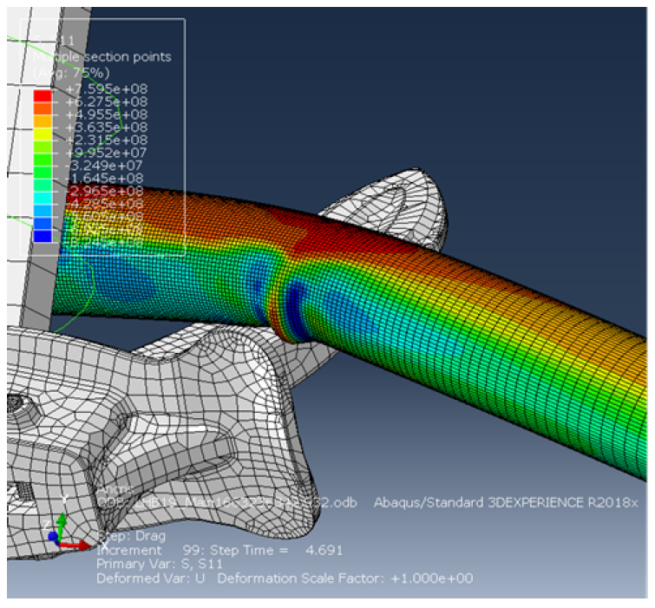
Context
Simulation of the physical response of a subsea pipeline dragged by a ship anchor.
With given design parameters, the response of the pipeline to an anchor hooking can be simulated with nonlinear 3D Finite Element Analysis (FEA).
Predicting this response is crucial for risk assessment. However, it requires many simulation runs, which are computationally expensive.
The simulation model is approximated using surrogate models based on Machine Learning techniques.
FEA simulation of a pipeline being dragged by the anchor. The figure shows the first principal stress distribution in the pipe wall during a hooking incident.

Slide 5
Objective

Slide 6
Objective
Can we trust a Machine Learning model’s predictions?
Machine Learning models might be overconfidently wrong.
Real-world applications require uncertainty quantification.
How can we build a Machine Learning based surrogate model providing accurate predictions and uncertainty estimates?
Machine Learning based surrogate model to approximate the simulation model’s input-output behaviour
Design parameters
Simulation
Physical response: Axial Compressive Strain
New case
ML based
surrogate model
Prediction of the response
Notes:
Modern deep learning based classifiers show very high accuracy on test data but this does not provide sufficient guarantees for safe deployment, especially in highstake AI applications such as medical diagnosis. Usually, predictions are obtained without a reliable uncertainty estimate or a formal guarantee.

Slide 7
Methodology

Slide 8
Methodology Underlying models
Predictive models:
Multilayer Perceptron
Uncertainty Quantification:
Monte Carlo dropout
Probabilistic output layer

Slide 9
Methodology Conformal Prediction
Inductive split Conformal Prediction.
Adaptive prediction sets by comformalizing scalar uncertainty estimates.
Procedure
Split the dataset into train and calibration sets $D_{train}$, $D_{calib}$
Train a Machine Learning model on $D_{train}$
Calculate non-conformity scores using $D_{calib}$ and the score function $s\left(x,y\right)=\frac{\left|y−\hat{y}\right|}{\hat{σ}}$ , $\hat{y}$ and $\hat{σ}$ are respectively, the point prediction and standard deviation estimate from the underlying model.
Define the error rate 𝛼∈[0,1] and compute $\hat{q}$ the ((𝑛+1)(1−𝛼))/𝑛 quantile of the calibration score, with n the size of $D_{calib}$.
Build prediction interval for $x_{new}$as $C\left(x_{test}\right)= \left\{y :s(x_{new},y)≤\hat{q}\right\}$

Slide 10
Methodology Validation Procedure
100 folds cross-validation

Slide 11
Experimental results

Slide 12
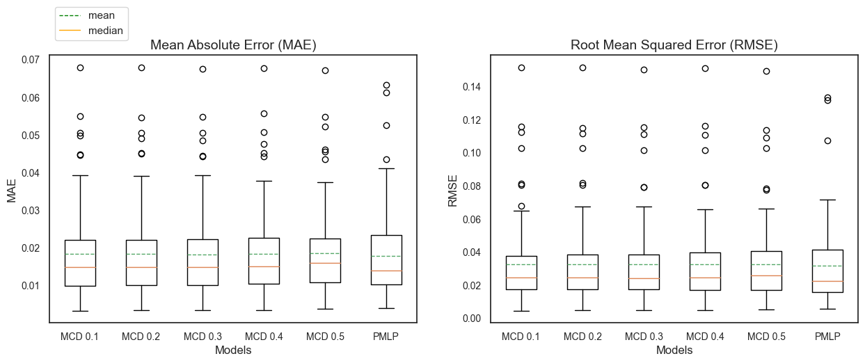
Results Accuracy and uncertainty performance
Accuracy performance
Distribution of performance metrics from the 100-folds cross-validation.
Accuracy metrics exhibit similar performance for all models.
Uncertainty metrics show differences in the performance of the models.
Uncertainty performance

Slide 13
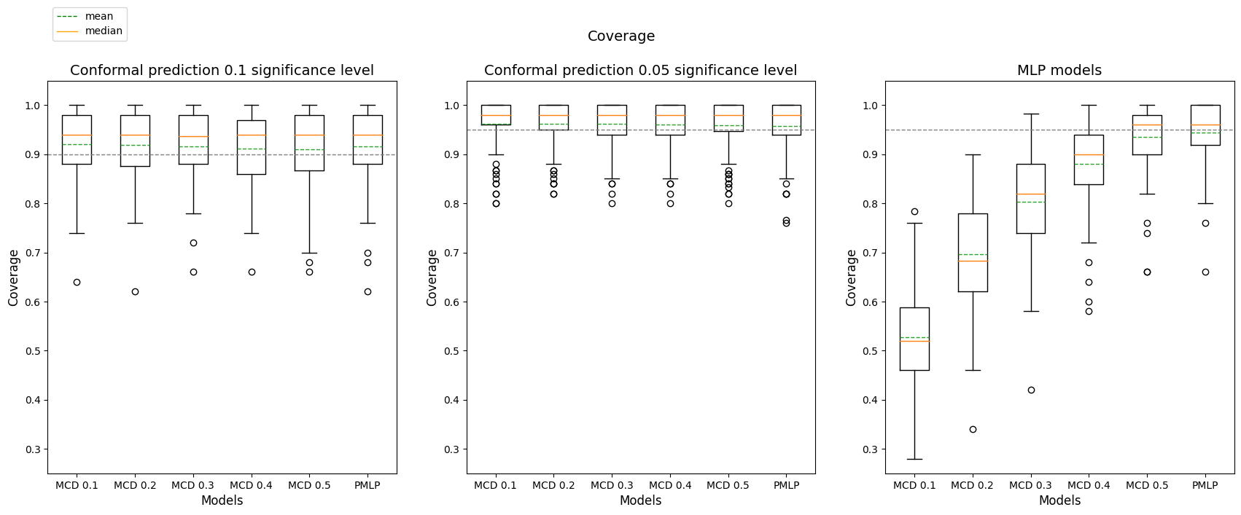
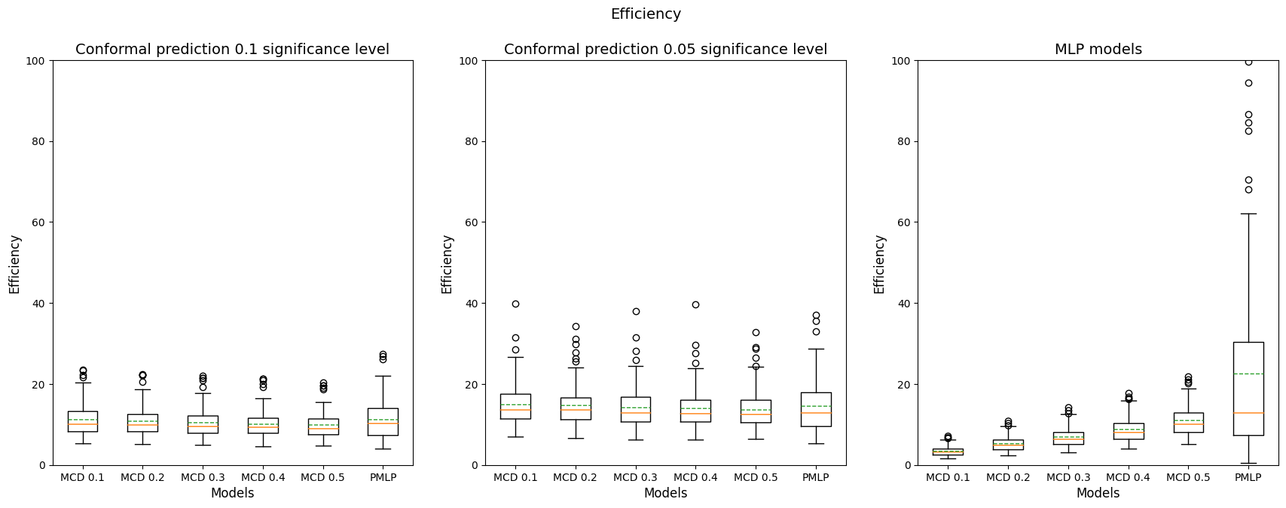
Results Conformal Prediction Performance
Distribution of the coverage and efficiency metrics from the 100-folds cross-validation.
The coverage of the MLP models is defined by +/- 2 standard deviations.
Conformal Prediction guarantees the coverage with a selected confidence level for all the MLP models.
Conformal Prediction improves the efficiency of the PMLP model.

Slide 14
Conclusions

Slide 15
Conclusions
Conformal Prediction improves the uncertainty quantification of Neural Networks
Conformal Prediction under distribution shift
Conformal Prediction and decision making

Slide 16
Thank you for your kind attention
Visit www.dnv.com/research
Sara El Mekkaoui
Senior Research Scientist at DNV Group Research and Development
sara.el.mekkaoui@dnv.com

