Slide 1
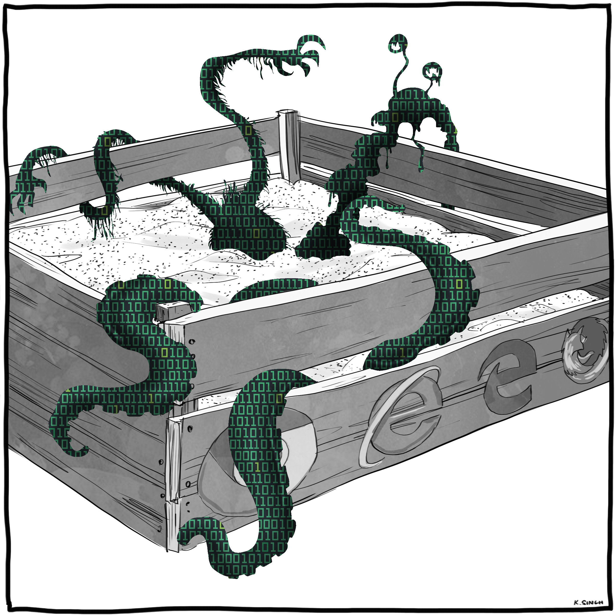
Evaluating potential sensitive information leaks on a smartphone using the magnetometer and Conformal Prediction
Robert Choudhury
Notes:
Consider changing to Khoungs intro slide

Slide 2
Introduction
Robert Choudhury Postgraduate Research Student
Former Software engineer for Telecoms software company
My work is supported by the EPSRC and the UK Government as part of the Centre for Doctoral Training in Cyber Security at Royal Holloway, University of London (EP/P009301/1).

Slide 3
Outline
Motivation – Smartphones and their attractiveness to attackers
Contributions
Background – Sensors / Turing
Methodology and experiment design
Results
Conclusions
Q&A
Notes:
Why this
Describe my methodology – how we have applied inductive conformal prediction to this problem
And after I have discussed our results you will have an opportunity to ask me questions

Slide 4
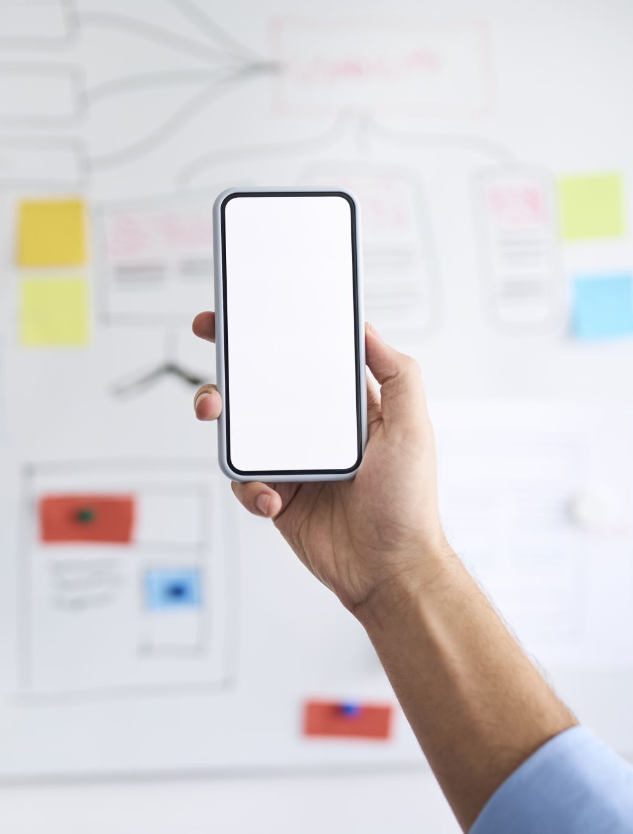
Motivation
6.9 billion smartphone users in the world today
71.9 percent use the Android OS
Smartphones are increasing in their computational power and storage
Used for sensitive actions
Videos / photos
Bank transactions
Email
Increasingly attractive target for attackers

Slide 5
Sensors providing context
Sensors added to enrich user experience.
Changes to UI based on Tilt (Orientation)
Navigation features using a compass
Temperature and air pressure
Collectively these are known as low powered sensors
They do not require permissions for sampling rates below 200hz
If they can be used to infer sensitive information their data is an attractive side channel for attackers.
Specifically interested in the magnetometer for this research
Notes:
Accelerometer, Magnetometer,
They do not require permissions as they are considered low risk - however recent inference attacks has led to reduction in the sampling rate (which we tested)

Slide 6
Contributions
We demonstrate that the magnetometer on a smartphone is sensitive enough to construct a reverse Turing test in certain cases that can be used as a trigger for offensive and defensive actions
Make use of a confidence measure based on Conformal Prediction to aid in identifying potential information leaks
Visualise the dataset and help identify the risk of sensitive information being leaked

Slide 7
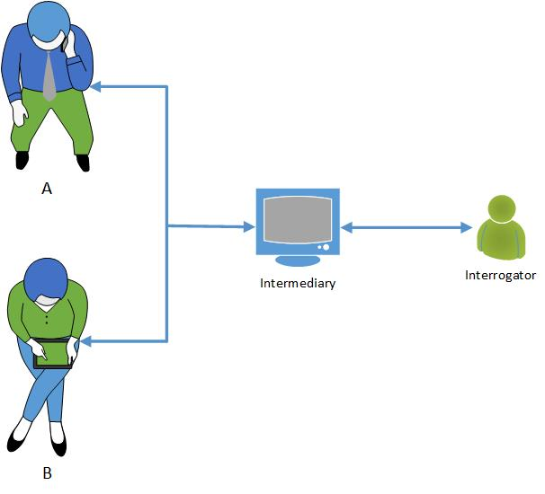
The Reverse Turing test
Derived from the original imitation game
How is it being used today?
Batterysavermobi
Artifacts – contacts / messages
Our research focuses on dynamic values. (They are harder to simulate)
Notes:
COMPUTING MACHINERY AND INTELLIGENCE – Alan Turing introduced us to the concept of the imitation game.
The Interrogator tries to find out which of A or B is a women / One of the entities is replaced by a computer programmed to respond and pretend to be human.
Android developers have made use of the accelerometer to detect if their malware was part of a virtual environment or a real persons phone
Malware has used
Computer determining if it is speaking to a person or a computer – this can be done using artifacts such as the mac address / contacts or lack thereof.

Slide 8
Experiments
Experiment 1: Detect if a phone has been deliberately cut off from a signal.
3 Experiments were designed of increasing difficulty
Started with a least difficult classification problem that represents a potential scenario for a reverse Turing test
Use a faraday bag to simulate a phone being offline
Chelsea Manning in a recent article asked journalist to place their phones in her microwave.
A hostile actor may wish to detect when a meeting of this kind is taking place
2000 readings were taken for this binary classification problem
Notes:
Experiment 1 is a binary case that shows that we can do a Reverse Turing test using the magnetometer
2-3 are experiments to see what we can achieve with a magnetometer at a low sampling rate with our current methodology
Experiment 2 – 3 classes user has the phone and presses on the

Slide 9
Experiments
Experiment 2: Infer typing on a touch screen
User is asked to type a number on a phone keypad (1,5,9).
Data is captured 600 times across the classes
A classifier is trained and with the goal of trying to predict which key was pressed
Properties of prediction set are examined
Notes:
Experiment 1 is a binary case that shows that we can do a Reverse Turing test using the magnetometer
2-3 are experiments to see what we can achieve with a magnetometer at a low sampling rate with our current methodology
Experiment 2 – 3 classes user has the phone and presses on the

Slide 10
Experiments
Experiment 3 : Examine possible leakage of sensitive information from the internal speaker.
This is most difficult experiment, we are measuring the small change in local magnetic field caused by the internal speaker.
Audio is played through the speaker and the data captured
Notes:
Experiment 1 is a binary case that shows that we can do a Reverse Turing test using the magnetometer
2-3 are experiments to see what we can achieve with a magnetometer at a low sampling rate with our current methodology
Experiment 2 – 3 classes user has the phone and presses on the

Slide 11
Experiments
Experiment 1: Detect if a phone has been deliberately cut off from a signal.
Use a faraday bag to simulate a phone being offline
Chelsea Manning
Experiment 2: Infer typing on a touch screen
User is asked to type a number on a phone keypad (1,5,9).
Experiment 3 : Examine possible leakage of sensitive information from the internal speaker.
This is most difficult experiment (10 classes) , we are measuring the small change caused by the internal speaker.
Notes:
Experiment 1 is a binary case that shows that we can do a Reverse Turing test using the magnetometer
2-3 are experiments to see what we can achieve with a magnetometer at a low sampling rate with our current methodology
Experiment 2 – 3 classes user has the phone and presses on the

Slide 12
Challenges
Magnetometer data affected by background noise
High dimensionality data which is a 3d representation of a magnetic field
The audio files in the data set are of a similar length and volume
Notes:
Regarding the audio files used in that were used for experiment 3 I used dynamic range compression to ensure that the audio files were of the same magnitude and as they are numbers 0-9 they are the same length. This is to isolate the changes in magnitude rather than having other clues to the classification.
Construct and app to capture data from the required sensor
Perform a series of sensitive actions whilst recording the sensor data
Threat model
Label the data /pre-process / visualise / classification
Challenges

Slide 13
General methodology
Notes:
Here is the generalist workflow of our experiments
We made use of the Nonconformist package along with Scikit learn to perform get our results.
LSTM was used because it gave us consistent and stable results – we wanted to work on time sequence data.
UMAP and TSNE initially used by UMAP proved to be more efficient

Slide 14
Preprocessing
Compute the total flux density
Simplify the data
Make the model agnostic to the orientation of the device
Creates an issue as impact of changes in a specific direction maybe masked
Normalise the data

Slide 15
Visualisation
Umap was chosen with the Cosine similarity metric
This metric effective with noisy data
Notes:
The cosine similarity measures the cosine of the angle between the two vectors and is a value between -1 and 1 where 1 means the two vectors are identical, 0 means they are orthogonal and -1 means they are opposite.

Slide 16
Inductive Conformal Prediction
When building our models we used Inductive Conformal Prediction because we would not have to retrain the model for each new test record.
We analysed the prediction set to see if what security properties would be leaked.
Notes:
Expand on this

Slide 17
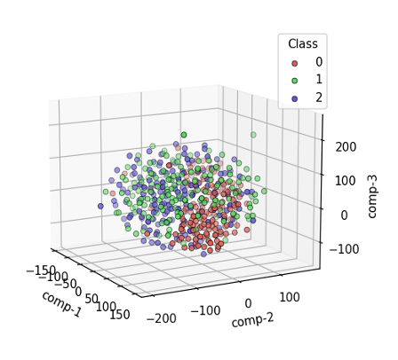
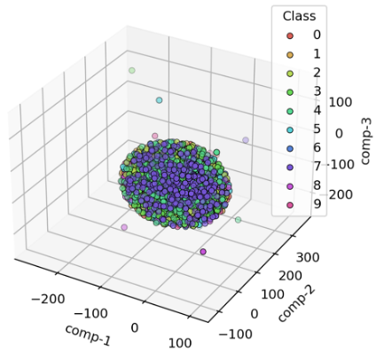
Visualisation
a) Exp 1
a) Exp 2
a) Exp 3
Notes:
Clear separation in Experiment 1 suggested that classifier performance would be high – clearly shows that you can perform a reverse turing test in this context
In experiment 2 and 3 overlapping classes suggested lower accuracy and a greater degree of uncertainty

Slide 18
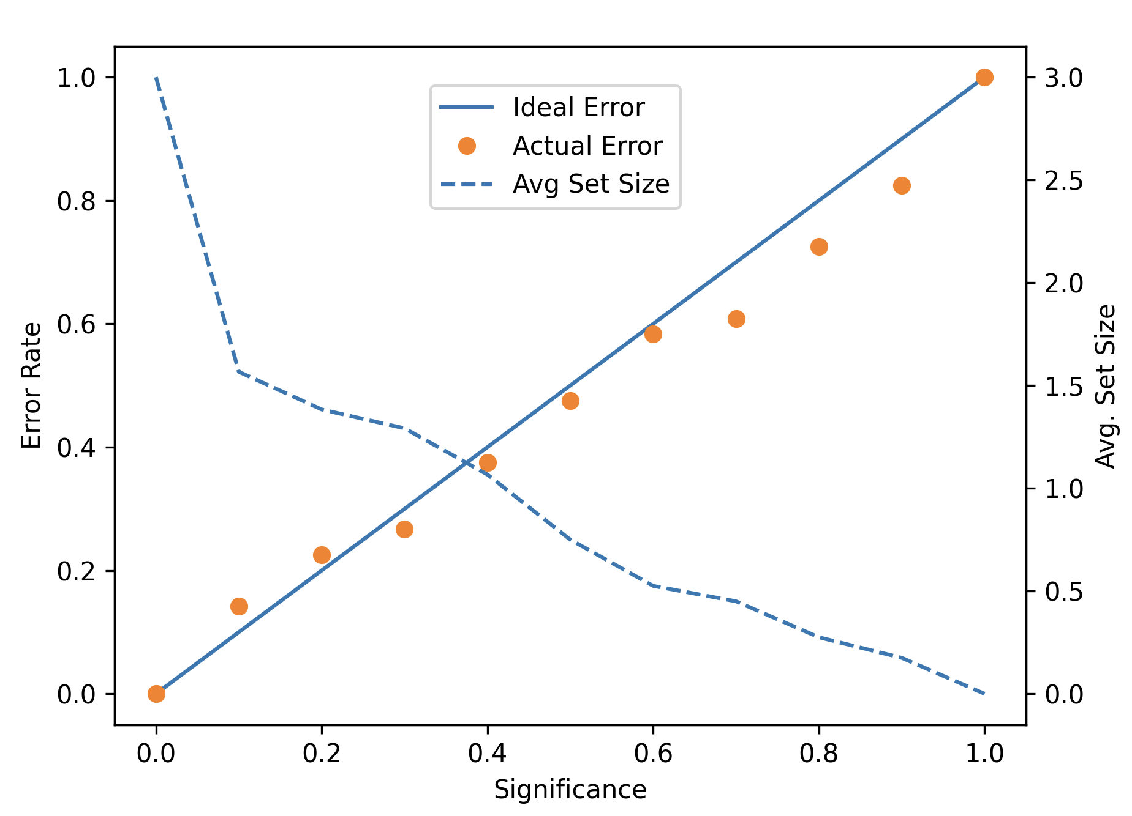
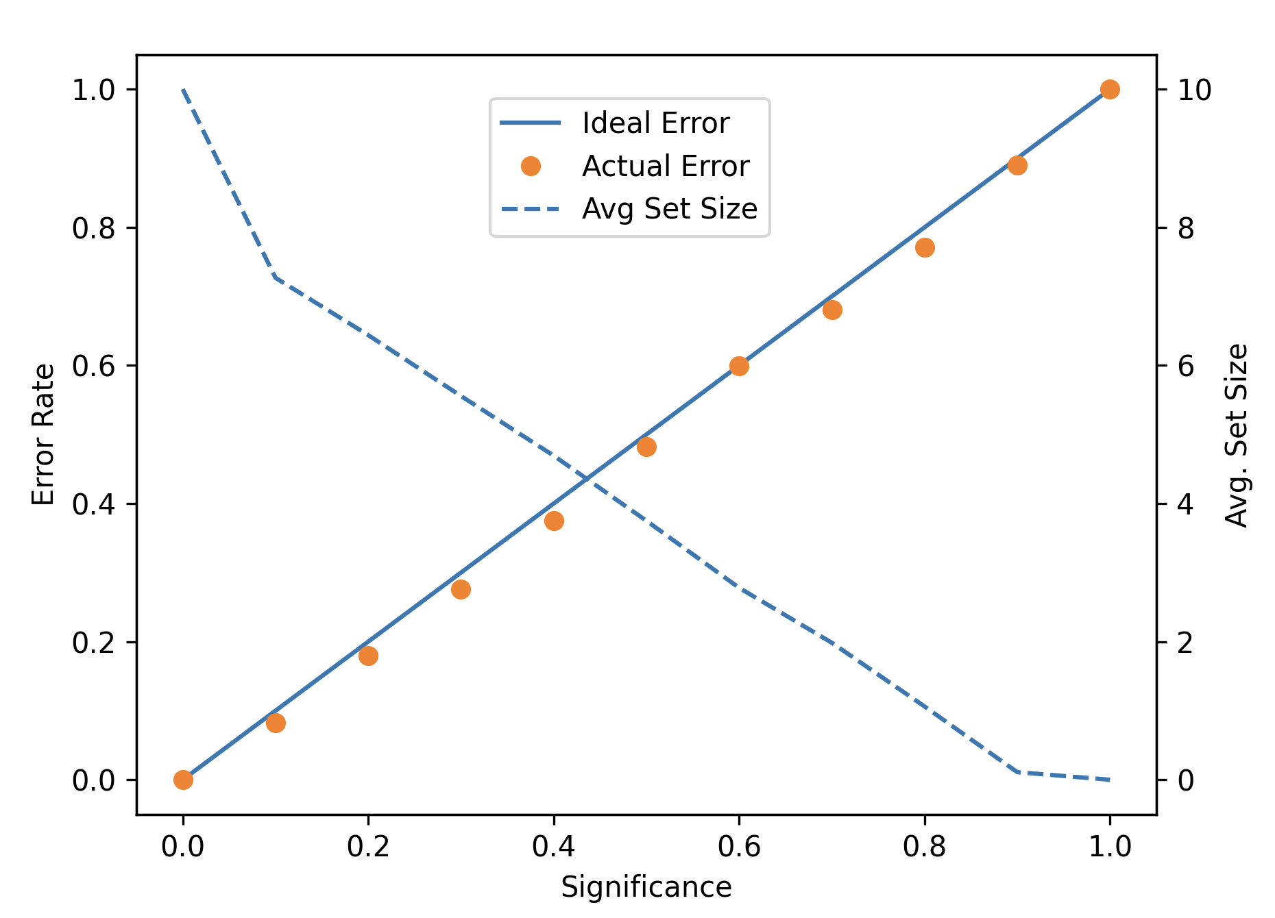
Calibration Curves
a) Exp 1
b) Exp 2
c) Exp 3
Notes:
The Curve follows the ideal x=y and the number of classes reduce as the significance level increases which is as expected

Slide 19
Empirical Results
Confidence level | Experiment | Uncertainty rate | Emptiness rate | Error rate
95% | 1 | 0 | 5.0 | 5.0
 | 2 | 64.17 | 0 | 6.67
 | 3 | 88.90 | 0 | 4.36
90% | 1 | 0 | 9.25 | 9.25
 | 2 | 55.83 | 0 | 10.83
 | 3 | 88.90 | 0 | 8.60
85% | 1 | 0 | 15.50 | 15.50
 | 2 | 49.17 | 0 | 15.83
 | 3 | 88.90 | 0 | 12.97
Notes:
In this section we look at the performance of ICP on the data sets produced by our experiments. These results present the average of three repeated experiments. The training data was further split from the standard 80/20 split for the LSTM model down to 48/32/20 for the training, calibration and test sets respectively.

Slide 20
Summary of Results
Experiment 1 Good performance supported by the clear separation in the corresponding visualisation
Further reflected in the fact there is 0 percent uncertainty
From a security standpoint apps can use this as a trigger to switch on a secondary action.
In Experiment 2 there is relatively high accuracy but with high uncertainty.
The central number in the keypad #5 was present in the prediction set 68.33 percent of time (85% confidence) which suggests there is a connection between the results and the keypad layout.
In Experiment 3 we believe the low level of accuracy is in part due to the audio set, the SNR and the sensitivity of magnetometer.
Notes:
For the sake of time I have summarised the results
Experiment 1 performs well as expected given the clear separation of the classes in the corresponding visualisation. This is reflected in the fact that in the test set there is zero uncertainty. We believe the reason for this clear separation is the high concentration of magnetic materials designed to deflect signals in a Faraday bag. In a security context this is undesirable as apps could be designed to detect this change in circumstance and then trigger an event such as turning on a secondary tracking mechanism for example recording accelerometer movements or the output of the microphone. A real world example is Chelsea Manning who was convicted of violations of the espionage act asked visitors to place their phones inside a disused microwave which acted as a Faraday cage to prevent eavesdropping on interviews after her release \cite{ChelseaManningMicrowave2017}.
In Experiment 2 there is relatively high accuracy as shown in the tables, however the uncertainty is high which shows that the model is finding it difficult to differentiate between classes. Uncertainty in this context could be used to show that the keys are relatively close together. For example key number 5 appears a dipropionate high number of times 67 percent (1 and 5 are close and so are 5 and 9)
In Experiment 3, classifying the magnetic field changes caused by the internal speaker proved to be very challenging. We believe the low level of accuracy is in part due to the use of sounds which are the same volume and the same length which is not typical of spoken language. Also we believe that the position of the sensor relative to the speaker is a factor.
The conformal predictor also confirms that the classifier is having difficulty distinguishing between classes with the value of uncertainty at over 88 percent.

Slide 21
Classifier Accuracy
Experiment 1 100%
Experiment 2 67.5%
Experiment 3 22.57% (Double Random)
Notes:
To identify the risks of a leak from raw data of a `sensitive' event we created a training data set labelled with the sensitive event and started with dimensionality reduction to highlight any potential relationships. A base classifier was trained three times using LSTM with a split of 80\%/20\% for training and test data respectively, the accuracy values were averaged and recorded above :

Slide 22
Conclusion and Future Work
We have presented a novel way to look for information leaks via a magnetometer data.
We have shown that due to the high noise and low sampling rate (0.025 % of the sampling rate of telephone audio) it is extremely challenging to perform classification of tasks that require high fidelity
We were able to implement a model that can with 100 percent accuracy perform a form of Reverse Turing Test
In the future we would like to Incorporate more sensors for comparison.
Vary the sampling rate to test how effective the current limit of 200hz is.

Slide 23
Questions?
23

Slide 24
Experimental challenges
Background Noise
Different types of speakers
High dimensionality
Classes are similar
24
Notes:
Many modern technological items use electricity or contain metal which will affect the electromagnetic readings around them. Another larger but constant factor is the strength of the Earth’s own magnetic field. As such the initial research challenge will be to reduce the background noise enough to prove that changes caused by the speaker can be detected by the magnetometer
There are two main classes of speaker piezoelectric and electrodynamic.
The latter type will produce changes to the magnetic field directly through the transducer and the vibration that it causes. A piezoelectric speaker generates vibrations through the inverse piezoelectric effect where the transducer is directly creating motion from electrical energy without the use of a magnet. In the case of a piezoelectric speaker, we would be looking to detect changes to the magnetometer brought about via vibration.
High dimensionality
Magnetometer only samples at 200Hz – we have to determine if this is sufficient to recognise human speech
Pre-processing of the data is required to present features in a way that can be used to filter noise and build a model.

Slide 25
Obtaining sensor information
Data is collected in 3-axes
Register with a listener
Method called when event occurs
Values are combined to make the model agnostic to orientation
The sensors we are researching do not require any permissions

Slide 26
Research Objectives
Demonstrate that state of the art security models on Android can be bypassed using low powered sensors such as the magnetometer to infer information which is considered sensitive (specifically inferring the sounds that a microphone could receive using the magnetometer).
Demonstrate that the magnetometer can be used to perform a reverse Turing test by detecting an adverse change in environment such as the device being placed in signal blocking bag. This can act as a trigger for software on the device to perform a privacy preserving action such as locking the screen or shutting down.
Compare inference attacks outside and inside faraday cage thereby demonstrating that inference attacks maybe more effective in a clean environment.
Contrast the vulnerability to information leaks from uncalibrated sensors and calibrated sensors. (limited to Gyroscope)

Slide 27
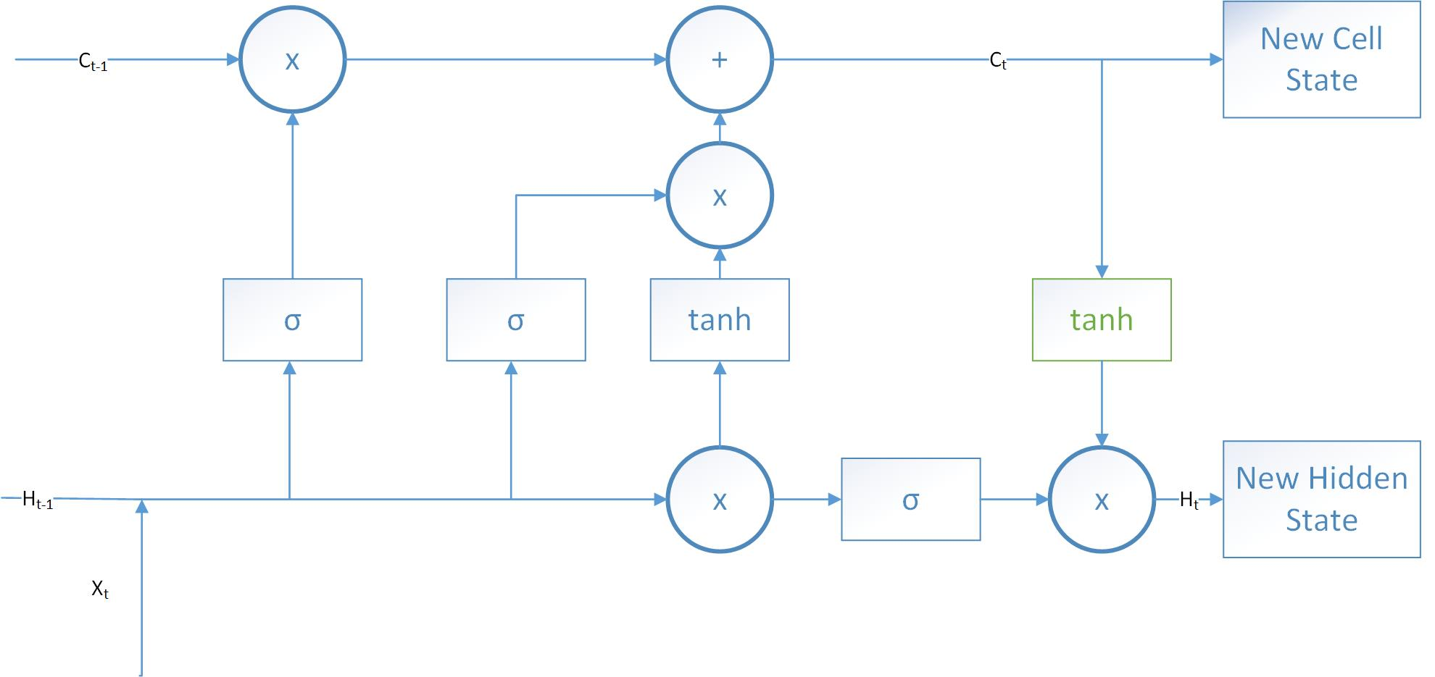
Long Short Term Memory (LSTM)
Remembers significant data
Hidden layer updates the Cell state when significant data is detected
27
Notes:
Sometimes the information you are looking to classify is not right next to each other – Example your hair is brown therefore you are a “Brunette” however if there is information between the important information traditional RNN will not be able to provide this classification.
In our context – because there is a lot of background noise we want the network to remember the significant features of the event we are trying to classify such as changes caused by the word “ONE” and not the noise following the event.
Forget Gate - These outputted values are then sent up and pointwise multiplied with the previous cell state. This pointwise multiplication means that components of the cell state which have been deemed irrelevant by the forget gate network will be multiplied by a number close to 0 and thus will have less influence on the following steps.

Slide 28
Context?
Image of previous research

