Slide 1
Application of conformal regression on real-world use cases with CREPES & MAPIE
COPA 2023
Nasir Uddin , Data Scientist, Husqvarna AI Lab, Sweden
Tuwe Löfström, Assistant Professor, Jönköping University, Sweden

Slide 2
Agenda
Husqvarna Group & AI Lab
Use Cases & CP:
Shipping container Demand prediction (supply chain)
QC of Plastic injection molding (factory)
Summary
Notes:
2

Slide 3
Husqvarna Group in brief
World-leader in outdoor products for forest, park and garden care, as well as equipment for light construction industry
333 years in business
14,700 employees, 28 production sites
Sales in 130 countries
Net sales SEK 47 bn. EBIT-margin 11.5%. Market capitalization of SEK 52bn
SALES DISTRIBUTION
29%
57%
14%
North America
Europe
Rest of the world

Slide 4
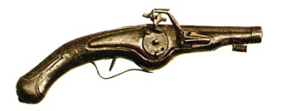
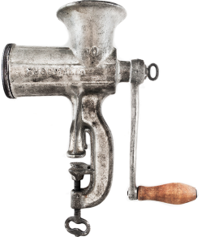
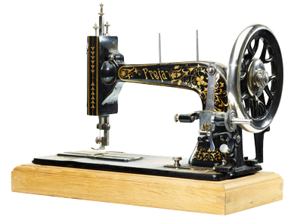
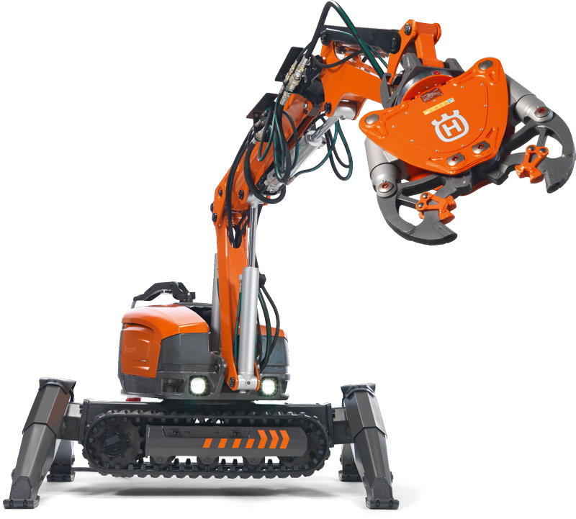
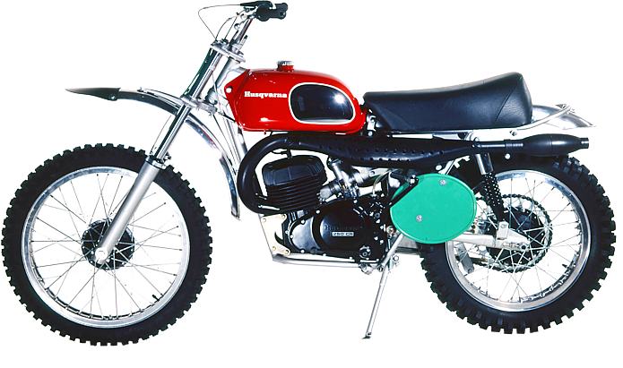
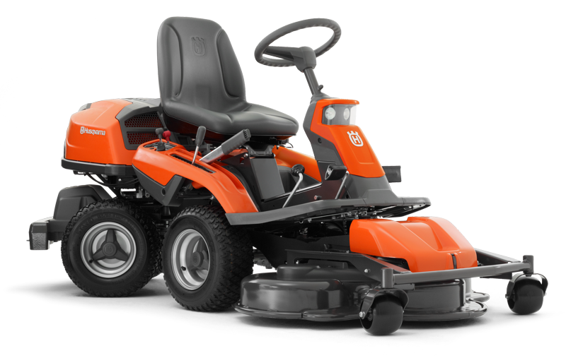
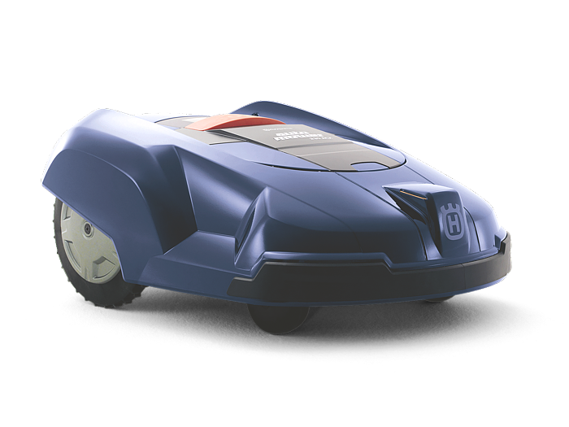
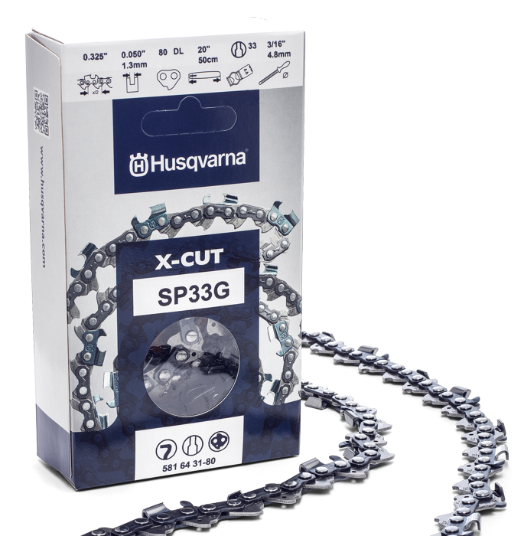
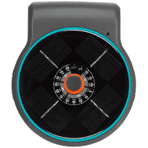
333 years of innovation
1689
1874
1872
1903
1959
1974
1987
1995
2009
2009
Auto Tune™
2012
2016
2018
2019
2020
4-wheel drive robotic mower for professional segment
MyGarden planner
EPOS
AquaBloom
Battery products with petrol performance
The Group’s first chainsaw chain
Launched Gardena Smart System
Notes:
Husqvarna´s heritage has played an important role in making us who we are today. Founded in 1689, Husqvarna is one of the oldest industrial companies in the world. For more than 333 years innovation and curiosity has always been at the heart of Husqvarna. This has led to a long line of successful products and solutions in very different areas, around 10,000 different products over the years - from weapons, sewing machines and motorcycles to outdoor power products for customers around the globe.

Slide 5
Strong, market-leading divisions
Husqvarna Forest & Garden Division
Gardena Division
Husqvarna Construction Division
Global leader in robotic mowers
Global no.2 in handheld products
Global leader in residential watering and smart garden systems
Strong position in garden tools
Global leader in power cutters
Leader in concrete surface and floors
Significant aftermarket business, incl. diamond tools
Share of Group net sales LTM
Share of Group operating income
Share of Group net sales LTM
Share of Group operating income
Share of Group net sales LTM
Share of Group operating income
60%
62%
25%
29%
15%
16%
SEK 29,099m
Operating margin: 11.8%
SEK 11,991m
Operating margin: 13.6%
SEK 7,511m
Operating margin: 11.7%
Note: Divisional EBIT does not sum up to 100% due to group common costs

Slide 6
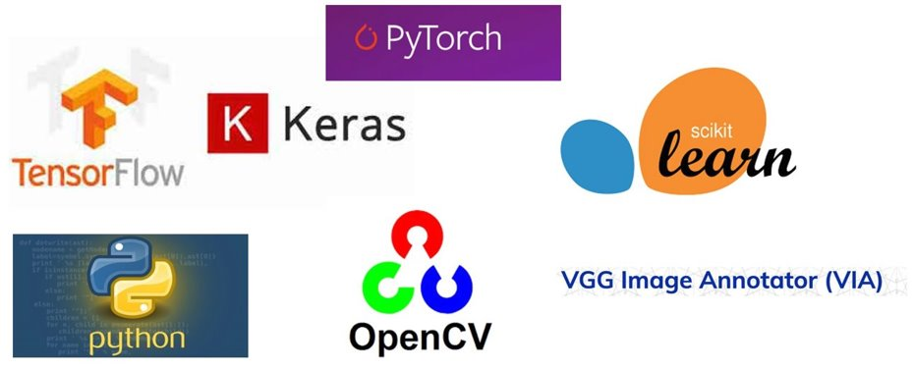
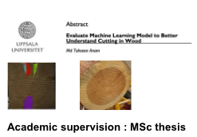
AI Lab: Activities & Tech stacks

Slide 7
AI as tool for RnD
AI enabled Services:
Chatbot/assistant, vision services
AI embedded devices:
intelligent machines, devices with tinyML/EdgeAI
AI as tool for RnD:
analytics, prediction, optimization, developing future products/services
Focus of today's presentation

Slide 8
Agenda
Husqvarna Group & AI Lab
Use Cases & CP:
Shipping container Demand prediction (supply chain)
QC of Plastic injection molding (factory)
Summary
Notes:
8

Slide 9
Conformal Regressors and Predictive Systems
The package implements conformal regressors, which transform point predictions (produced by any underlying regression model) into prediction intervals, for specified levels of confidence.
The package also implements conformal predictive systems, which transform the point predictions into cumulative distributions (conformal predictive distributions), e.g., allowing prediction intervals to be extracted as well as probabilities for the target value falling below specified thresholds.
The package implements standard, normalized and Mondrian conformal regressors and predictive systems, and allows for using both built-in and tailored difficulty estimates and Mondrian categories.
Link:
https://proceedings.mlr.press/v179/bostrom22a/bostrom22a.pdf
https://github.com/henrikbostrom/crepes

Slide 10
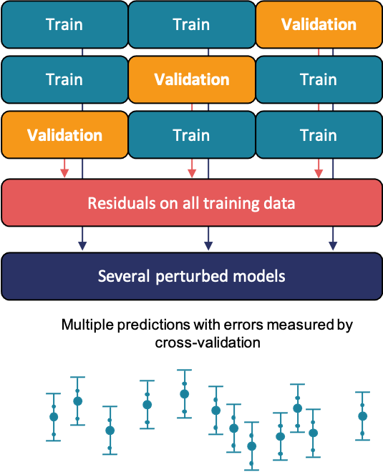
Conformal Prediction (MAPIE)
MAPIE - Model Agnostic Prediction Interval Estimator
MAPIE allows to easily estimate prediction intervals (or prediction sets) using scikit-learn-compatible model for single-output regression or multi-class classification settings.
Prediction intervals output by MAPIE encompass both aleatoric and epistemic uncertainties and are backed by strong theoretical guarantees thanks to conformal prediction methods
How does Mapie works for regression?
Based on cross-validation and relies on: - Conformity scores on the whole training set obtained by cross-validation,
Perturbed models generated during the cross-validation.
MAPIE then combines all these elements in a way that provides prediction intervals on new data with strong theoretical guarantees

Slide 11
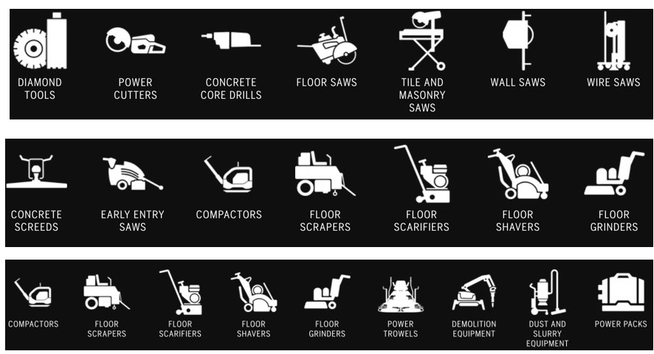
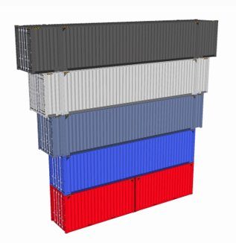
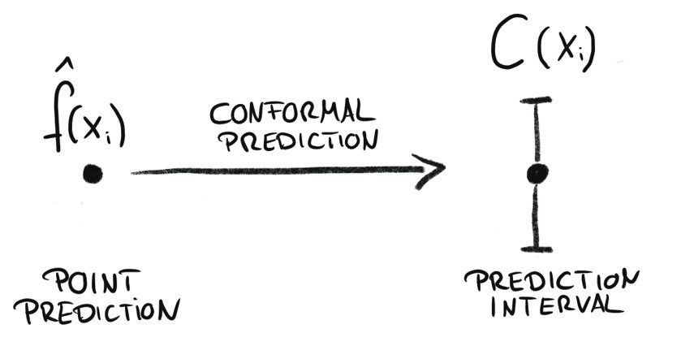
Container demand prediction
Situation
Challenge
Expected outcome
Part of Husqvarna Construction has factories in Asia and demand for containers shipped with construction products should be forecasted at least four weeks ahead of delivery.
Demand planning needs to to be done, in order to secure shipment and reduce unnecessary costs.
Currently planning and ordering of containers done manually through internal communication of various teams.
No machine learning or statistical methods being used for forecasting & order planning.
Lack of understanding the relationship between constructions products category and containers demands
Study historical demand data of constructions products and quantity of containers with time series approached in order to understand trends, seasonality as well relationships product groups and demands.
Identify the key products groups and other driving forces contributing container volumes
Generate, evaluate and deploy forecasting AI methods with conformal predictions

Slide 12
Datasets
Historical data of container demand: Weekly total container demand in TEU for specific route X.
Product categories: Quantity of product ordered from various product category classes mentioned as CCE, CDE, CSE.
Date: Week when containers were loaded for shipment from the manufacturing or assembly location

Slide 13
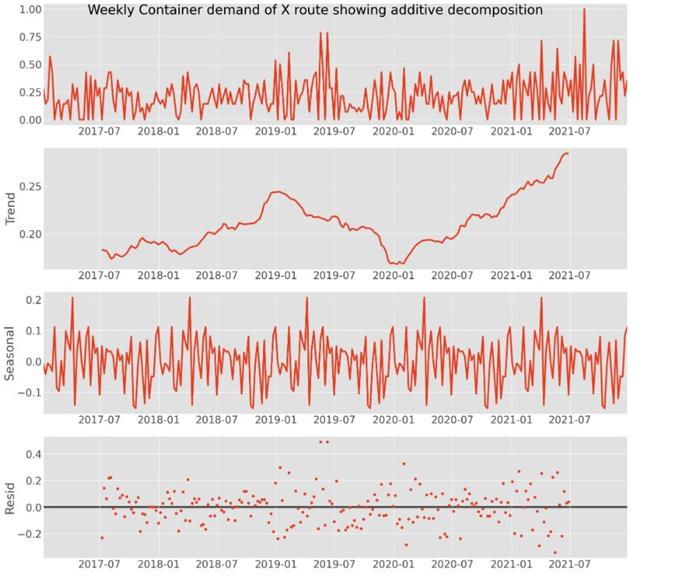
Container demand: ETS decomposition
Trend : A long-term increase or decrease in the data. This can be seen as a slope (is doesn’t have to be linear) roughly going through the data.
Seasonality : A time series is said to be seasonal when it is affected by seasonal factors (week, month, year, etc.).
Residuals : Each time series can be decomposed in two parts: - A forecast, made up of one or several forecasted values - Residuals. They are the difference between an observation and its predicted value at each time step.

Slide 14
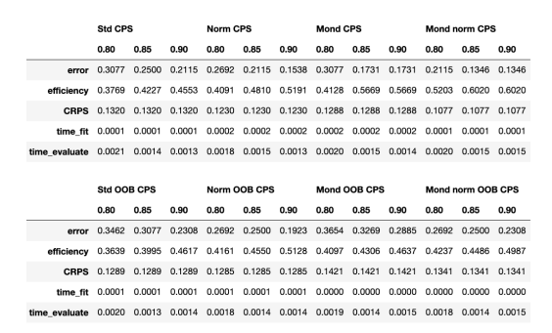
Container Demand : Conformal Predictive system (CPS)

Slide 15
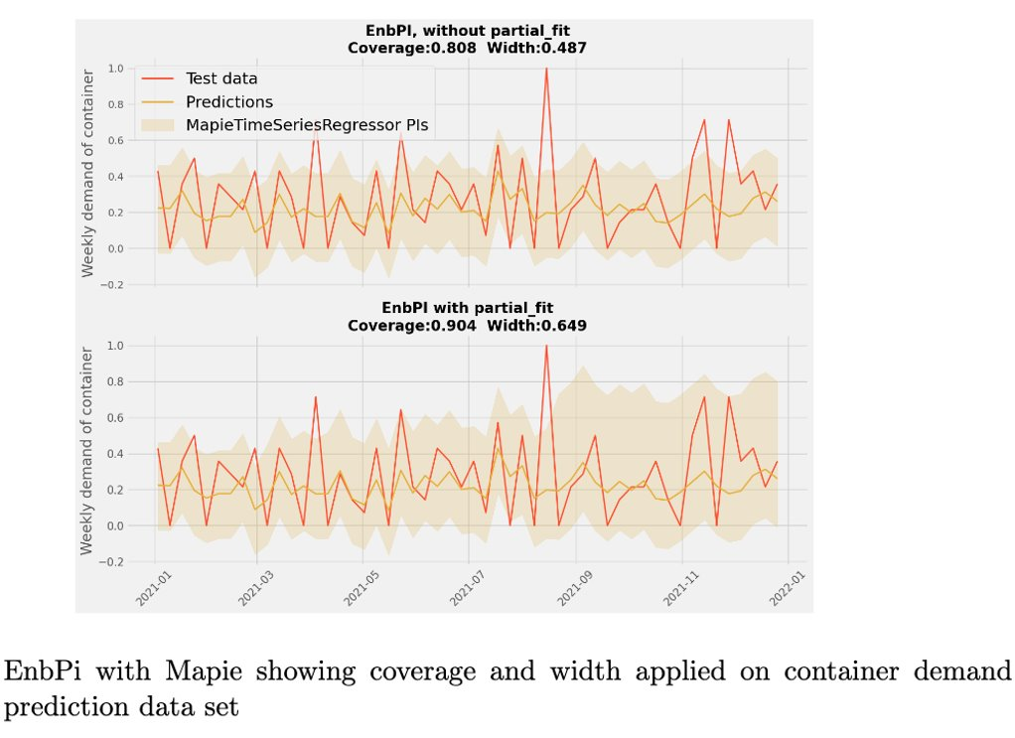
Container demand : EnbPI with Mapie

Slide 16
Agenda
Husqvarna Group & AI Lab
Use Cases & CP:
Shipping container Demand prediction (supply chain)
QC of Plastic injection molding (factory)
Summary
Notes:
16

Slide 17
Injection molding
A manufacturing process in which molten material is injected into a mould to produce parts.
Insert Materials (e.g.-Plastic)
Mould
Closed
Filling Process
Holding pressure
Cooling
open mould
Notes:
17

Slide 18
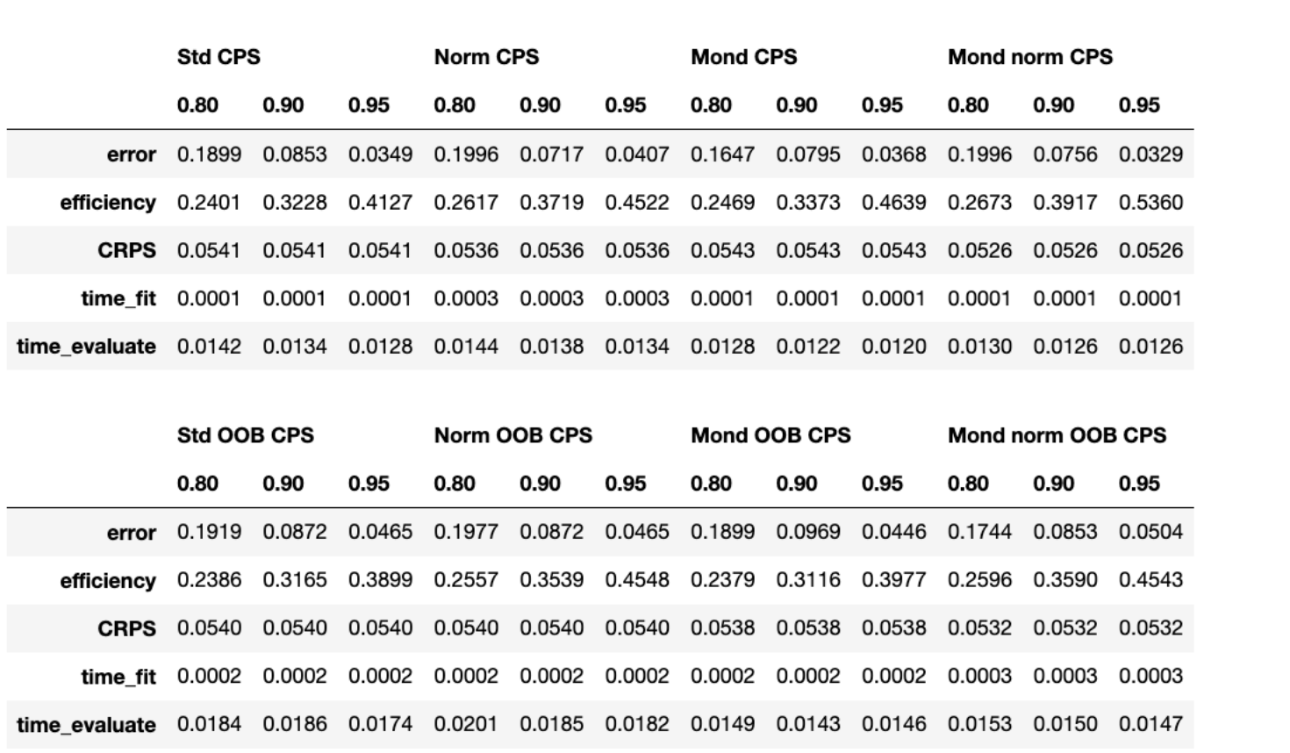
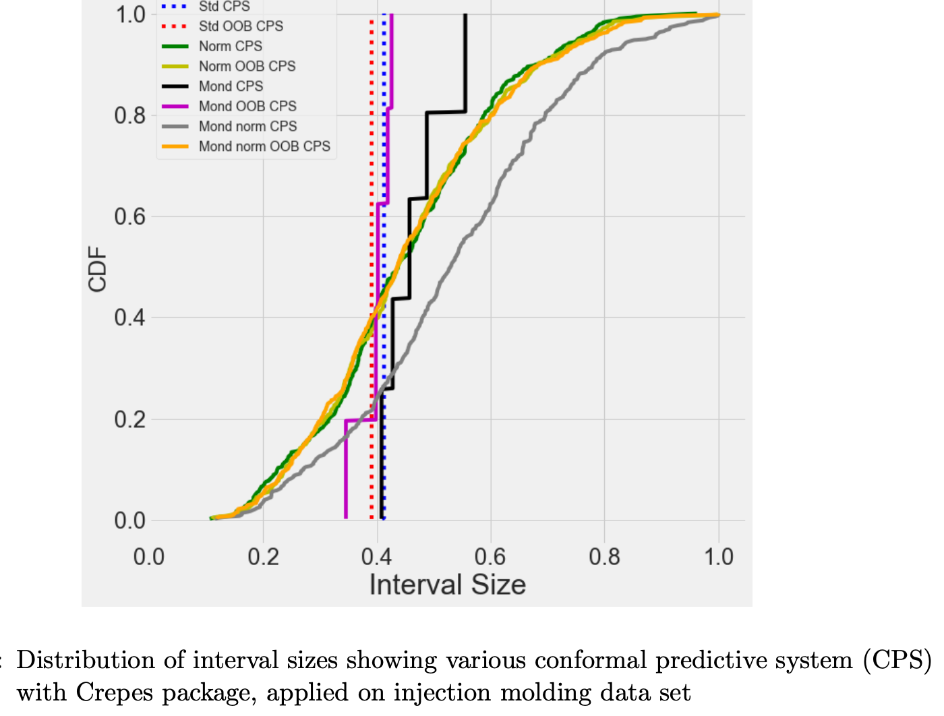
Injection molding QC : CPS

Slide 19
Injection Molding QC: EnbPI with Mapie

Slide 20
Summary-1
Various Conformal Predictive systems (CPS) were evaluated with CREPES
EnbPI Method were implemented with MAPIE
For Shipping Container Demand prediction:
Achieving good results regarding both validity(calibration/coverage) and efficiency (width/sharpness) with any probabilistic prediction methods including conformal prediction is very challenging.
Due to the data set’s non-exchangeability and smaller size, only normalized Mondrian CPS gave close to the valid prediction error and lowest CRPS in the Crepes platform.
Results from MAPIE with EnbPI also deviate from the expected coverage.
MAPIE could be a practical option in real-world production use cases since it has a user-friendly API suitable for time series data sets supporting various methods
CREPES to see the probability distribution at a glance and helpful for decision-making
Notes:
Nasir 1 min

Slide 21
Summary-2
For Injection Moulding Usecase:
Unlike Container Demand usecase, all of the CP methods gave expected valid coverage applied in Crepes and MAPIE platforms
it would be interesting to see which parameters are easier to control and optimize as well as which will have the maximum impact to stabilize the process
could be applied for monitoring quality control by providing prediction intervals or sets that have guaranteed coverage under certain assumptions.
In addition to validity (which is a must-have criterion), the efficiency or sharpness parameter must also be taken into consideration. This is particularly important in this use case, where the final plastic weight must not deviate too much (e.g., maximum 0.29% variation).
Notes:
Nasir 1 min

Slide 22
Why Do we need Uncertainty prediction?
When we use model predictions to make decisions
When we want to design robust systems that can handle unexpected situations
When we have automated a task with machine learning and need an indicator of when to intervene
When we want to communicate the uncertainty associated with our predictions to stakeholders
in situations where the demand must meet a certain threshold in order to justify production
a rule of thumb, uncertainty quantification is needed whenever a point prediction isn’t informative enough

Slide 23
Conformal Prediction
Prediction interval: an estimate of the interval the observation will fall in, with a certain level of confidence.
Conformal Prediction: a model agnostic method to calculate uncertainty estimates for a supervised problem.
MAPIE - Model Agnostic Prediction Interval Estimator (python library for CP)
Crepes: Conformal regressors and predictive system (python library)

Slide 24
Conformal Prediction
Conformal predictors are predictive models that associate each of their predictions with a measure of confidence.
Given a test pattern xi , and a significance level ϵ, a conformal predictor outputs a multi-valued prediction region Γ ϵ i containing the correct target yi with probability 1 − ϵ.
For classification, the prediction regions are sets of class labels, and for regression they are prediction intervals.
https://doi.org/10.1016/j.xphs.2020.09.055

