Slide 1
Uncertainty Quantification for Metamodels
Martin Okánik, Athanasios Trantas
Marijn Pepijn de Bakker, Elena lazovik
Netherlands Organisation for Applied Scientific Research – TNO
Advanced Computing Engineering

Slide 2
Metamodelling
Sometimes a full physical simulation is impractical (computational cost too high)
Data-driven metamodels can achieve most of the precision at much smaller cost
2 ways we can train models:
(i) directly the real-world data common ML
(ii) physical model output that we want to emulate metamodelling
metamodel building
metamodel deployment
Notes:
This was a proof-of-concept study, so we have not actually deployed the metamodel.

Slide 3
Challenges in uncertainty quantification (UQ) for metamodelling
UQ should be computationally cheap
Desired: metamodel outputs a mean prediction + prediction interval (PI)
Dilemma: computational expense of building PIs
Simple deterministic metamodel (e.g. MLP)
mean
data
More expensive stochastic metamodel (e.g. Bayesian NN)
mean + PI
can end up equally expensive!
Physical simulation with/without PIs
mean (+ PI?)
Notes:
Focus on the apparent dilemma between powerful UQ and computational affordability. We are laying out a problem that we want to solve.

Slide 4
Additional complications
UQ should be cheap AND model-agnostic
UQ scheme should be independent of existing scheme for the mean prediction, be built built “on top” of it, not added inside
Metamodel (re-)training tends to be very expensive, even when prediction is cheap
Many deterministic metamodels have been in operation for a long time, need data consistency
Can use conformal prediction (CP) for producing PIs. CP is:
(i) computationally cheap
(ii) model-agnostic
But how to ensure adaptivity of produced PIs? (i.e. conditional coverage)

Slide 5
Proposal: leveraging the output space
Metamodel output ($\hat{y}$) in practice almost always holds significant correlations to the difficulty of data points, propagated from the input space
These can be leveraged one output dimension at a time, avoiding the curse of dimensionality in the input space – making it a simple 1D problem
This 1D pattern is suitable for a polynomial regression with only a few parameters
Estimating PI for given $\hat{y}$ becomes as simple as evaluating said polynomial
Simple deterministic metamodel
$$φ$$
Mean metamodel output
$$\hat{y}=φ(X)$$
Learn the pattern between the mismatch $\left\langle \left|y−\hat{y}\right|\right\rangle$ and $\hat{y}$
train set (phys. model output)
$$X$$
validation set (phys. model output)
$$y$$

Slide 6
Algorithm for adaptivity of PIs
For each output dimension of the metamodel separately:
Come up with an initial scalar guess of PIs with half-width $δ_{0}$, e.g. with simple CP
Divide metamodel output $\hat{y}$ into $N$ bins, ordered by size ($\hat{y})$
Compute the mean coverage $C_{b}$ for $b$-th bin using PI:$\hat{y}±δ_{0}$ $(b=1…N)$
Choose a metric $M$ of departure from the desired coverage $1−α$ (“miscoverage”); this is a scalar obtained e.g. by averaging $C_{b}−(1−α$) through $b$, $b=1…N$
Choose a parametric function $f(\hat{y}; p)$ that scales $δ_{0}$ along $\hat{y}$
Optimise the parameter vector $p$ for minimal $M$
Optional: re-run CP to ensure marginal validity is still satisfied (only a modest correction expected, since target of opimisation is conditional validity with the same coverage)
Result: optimised function $f(\hat{y}; p)$ scaling $δ_{0}$ such that $C\left(\hat{y}±fδ_{0}\right)\sim 1−α, ∀\hat{y}$
Notes:
The core of what we do.
Notes for individual numbered stages of the algorithm:
In other words generate a number that represents a non-adaptive PI, make sure it has correct coverage by an additive correction due to CP.
We need these bins because we need a sample for estimating coverage. In principle we could do some rolling window rather than fixed bins, but that would be more complicated.
Coverage < desired => PI too narrow etc.
RMSCM, will be introduced shortly
P had 2-3 components in our study
Grid search if dim(P) low enough, any reasonable way will do – it really does not matter how expensive this is since it will always be much cheaper than training the surrogate, and is only trained once

Slide 7
Use Case: BioDT
Why Biodiversity?
The resilience of our ecosystem depends on the intrinsic interdependence between all the different species and their interactions
Is vital for the prosperity of all life on earth
Under threat due to broad anthropogenic changes
Significant impact on Earth’s ability to sustain life
https://biodt.eu/
Notes:
Experiment design and the question are very important. If we can outperform a BNN, then our method shows potential.

Slide 8
Case study:
Environmental agent-based model for the collective dynamics of grass growth
16 inputs (features), 12 outputs (tasks), black-box
12500 data points: 6250 for metamodel training, 6250 for UQ
Action:
Build two metamodels based on:
(i) Bayesian Neural Network (BNN): expensive, stochastic, should produce adaptive PIs with no further UQ technique
(ii) Multilayer Perceptron (MLP): cheap, deterministic, produces no PIs
Question: are the PIs constructed by MLP + our algorithm comparable to a BNN?
Notes:
Experiment design and the question are very important. If we can outperform a BNN, then our method shows potential.

Slide 9
Comparision of metamodels
Hidden layers:
MLP: (16 in) – 64 – 32 – (12 out)
BNN: (16 in) – 128 – 256 – 512 – 256 – 128 – (12 out)
Performance for the mean prediction (physical model being the “ground truth”):
Fairly comparable!
model/score | R^2 | RMSE
MLP | 0.911 | 0.271
BNN | 0.906 | 0.262
Notes:
R2 and RMSE are some of the most widely used metric. The purpose of the table is just to show both baseline surrogates are reasonable for predicting the mean, in other words that we are comparing apples with apples.
If they ask, mention that we also built a larger MLP and a smaller BNN, the size of the hidden layers is not crucial – neither for performance nor for execution time. Such difference in size generates a factor of 10 in execution time, but the ratio MLP to BNN execution times is primarily set by the number of evaluations of the BNN we desire to get good statistics – this can easily be 100 or more. More on this on supplementary slides.

Slide 10
Quantifying miscoverage in binned data
Divide metamodel output $\hat{y}$ into $N$ bins, ordered by size, then define the Root Mean Squared Conditional Miscoverage (RMSCM):
$$RMSCM= \sqrt{\frac{1}{N}\sum_{b=1}^{N}{{(C_{b}−\left(1−α\right))}^{2}}}$$
Aim: $C_{b}≈\left(1−α\right)$ across $\hat{y}$ axis, i.e. $RMSCM→0$
Notes:
This is just one design that we thought of and worked well. The main thing is that it is somehow built from summing positive magnitudes of C_b – (1-\alpha), which is the core of what we want to measure. Mean absolute conditional miscoverage obtained from \sum | C_b – (1-\alpha)| would also be valid….

Slide 11
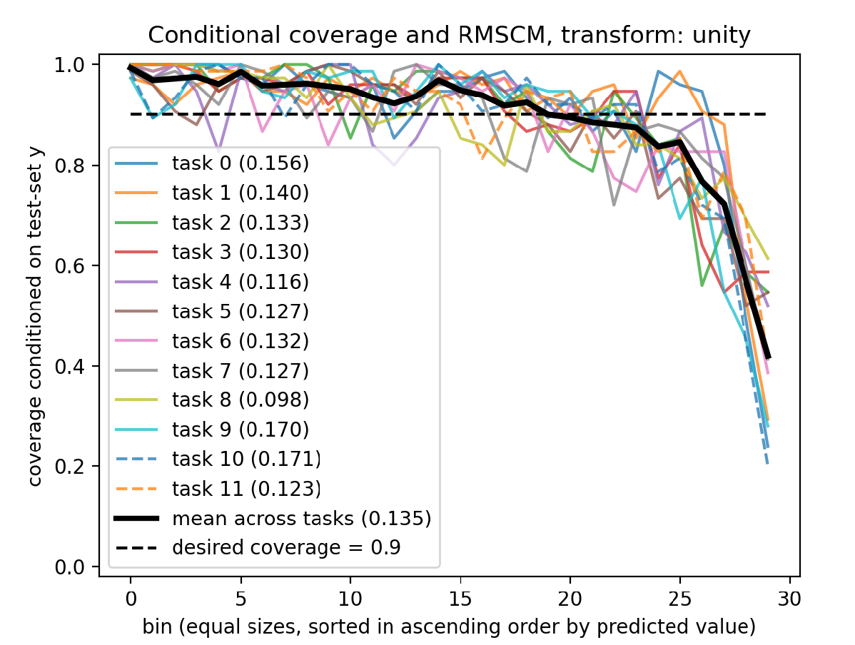
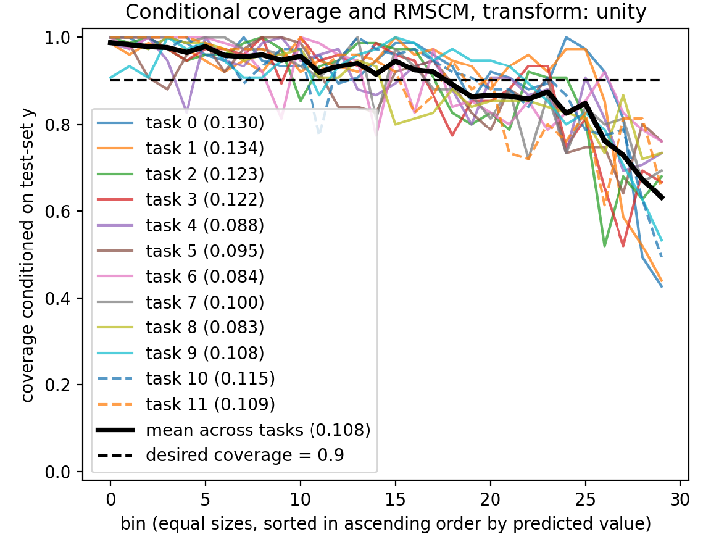
Miscoverage after CP, but before RMSCM optimisation
MLP with marginal coverage
RMSCM = 0.135
BNN with marginal coverage
RMSCM = 0.108
Notes:
Take care to properly explain the graphs and mention these elements:
hor. Axis: bin (0 = y_hat closest to median, 30 = y_hat furthest from median – “spikes”)
Vert. axis: coverage of the given bin
Colorful curves: coverage of individual tasks (output dims)
Thick black curve: task mean coverage
Dashed line: target coverage of 90% that we want to approach
Observations to make:
When coverage falls down beyond bin 20-25: this means that errors are larger for y-hat further from its median behaviour (not inevitable, but hardly surprising), so a constant width PI has smaller coverage there
“after CP” in the slide title means that we have marginal coverage, so the average height of all the curves is the same as the dashed line, they are sometimes below and sometimes above because the PI cannot adapt to changes along y-hat
Figure on the right: the fall of coverage beyond bin 20-25 is gentler, because the BNN produces somewhat adaptive PIs, but apparently it is not enough
Even if they do not get the figures, the RMSCM numbers below still convey the message
NB: in one bin, there is ~100 data points, that’s why it is quite noisy

Slide 12
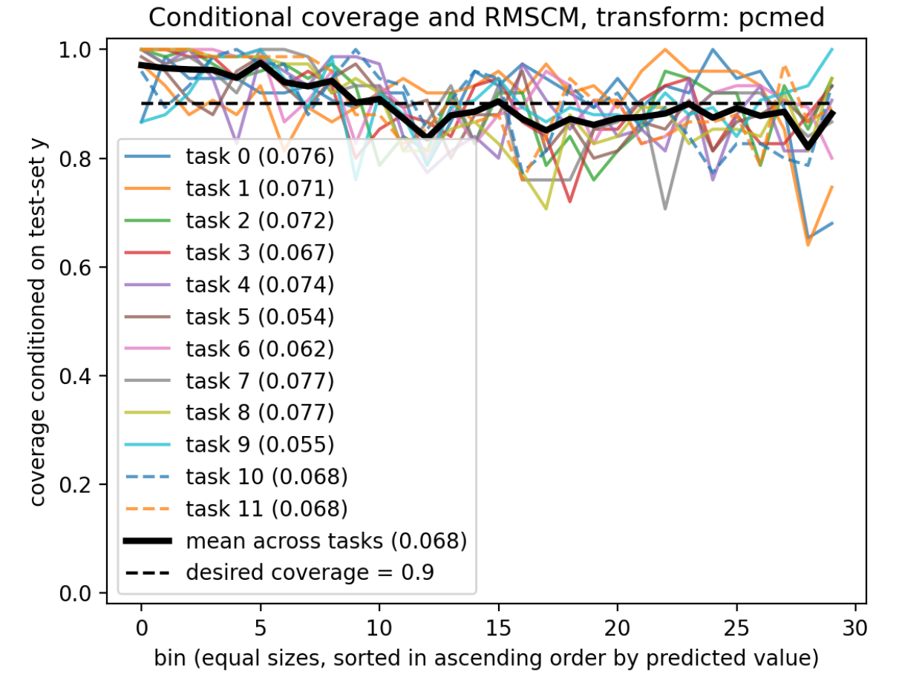
Adaptivity after RMSCM optimisation
Optimising a 3-parameter transformation…
$$f\left(\hat{y}, p\right)=1+p_{1}y_{∗}+p_{2}{y_{∗}}_{}^{p_{3}}$$
where $y_{∗}=\frac{\left|\hat{y}−Median \hat{y})\right|}{Mean \left|\hat{y}\right|}$
…leads to a 2-fold decrease in RMSCM
NB: optimising BNN does not make it better than optimised MLP
MLP with partial conditional coverage
RMSCM = 0.068
Notes:
Contrast RMSCM = 0.068 for “MLP + CP + our UQ” vs. 0.0135 for “MLP + CP” and 0.108 for “BNN + CP”
The variable y_* was invented because the difficulty of data points increases in both directions (spikes come upwards and downwards), y-hat would not be as good variable for our function (it would not be monotonous). This is a case-specific convenience, up to each researcher to do what makes sense for the dataset they have…

Slide 13
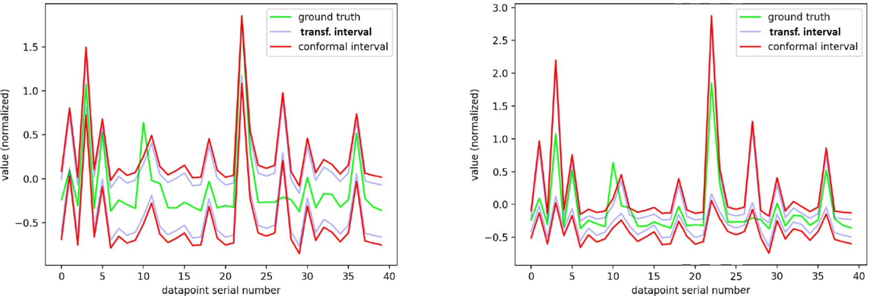
How it looks in terms of PIs
MLP with marginal coverage
- intervals with constant width
RMSCM = 0.135
MLP with partial conditional coverage
- intervals with adaptive width
RMSCM = 0.068
Notes:
Message we want to get across:
- In principle nothing new, just a more visual demonstration of how PIs get wider or narrower for different regions of output space
Explanatory remarks to these graphs:
NOT a time series, randomly chosen 40 datapoints (connected only to make the plot less visually cluttered)
These are the same points on the left and on the right: the green curve shows the ground truth
(i) Bluish & (ii) red lines show upper and lower end of PIs (i) after transformation (which is None/unity on the left) and (ii) after the final CP (so the red curve is the final prediction). Distinction between red & blue is not important, focus on one of them. What matters is the relationship between the green and e.g. red patterns.
Left: constant width PIs, Right: adaptive PIs after RMSCM optimisation (notice that they are wider at places when there are peaks on the green curve
NB: y-hat, which determines the amount of scaling of PIs is not the green curve (which is the ground-truth), y-hat is the center point between the lower and upper red curves, which is the same to the left and right, it is only the width of PIs that change, however this correlates quite well with the green curve, since model is reasonably good at predicting the mean

Slide 14
Impact
We showed that (relatively) cheap deterministic NN + our cheap empirical UQ technique can produce better adaptivity of PIs than an expensive stochastic NN
Core of the technique: CP + leveraging the output space of the metamodel
Not guaranteed that enough information exists in output space
…but easy to test whether there is, and likely good enough in most practical problems
Method is easy to implement on top of existing deterministic metamodels (not just NNs), with full backwards consistency of the mean predictions – no changes to these at any point
Future work:
Generalise across other use cases
Apply to time-series forecasting tasks
Notes:
Third bullet point casts some degree of doubt on our work, but more arguments to our defense are in the very first backup slide.

Slide 15
References
Anastasios N Angelopoulos and Stephen Bates. A gentle introduction to conformal prediction and distribution-free uncertainty quantification. arXiv preprint arXiv:2107.07511, 2021.
Claudio Angione, Eric Silverman, and Elisabeth Yaneske. Using machine learning as a surrogate model for agent-based simulations. Plos one, 17(2):e0263150, 2022.
Laurent Valentin Jospin, Hamid Laga, Farid Boussaid, Wray Buntine, and Mohammed Bennamoun. Hands-on bayesian neural networks—a tutorial for deep learning users. IEEE Computational Intelligence Magazine, 17(2):29–48, 2022a. doi: 10.1109/MCI.2022. 3155327.
David John Cameron MacKay. Bayesian methods for adaptive models. California Institute of Technology, 1992b.
Harris Papadopoulos, Vladimir Vovk, and Alexander Gammerman. Regression conformal prediction with nearest neighbours. Journal of Artificial Intelligence Research, 40:815–840, 2011.
Rylan Perumal and Terence L van Zyl. Surrogate assisted methods for the parameterisation of agent-based models. In 2020 7th International conference on soft computing & machine intelligence (ISCMI), pages 78–82. IEEE, 2020.
Franziska Taubert, Karin Frank, and Andreas Huth. A review of grassland models in the biofuel context. Ecological Modelling, 245:84–93, 2012.
Athanasios Trantas, Ruduan Plug, Paolo Pileggi, and Elena Lazovik. Digital twin challenges in biodiversity modelling. Ecological Informatics, page 102357, 2023.
Vladimir Vovk, Alexander Gammerman, and Glenn Shafer. Algorithmic learning in a random world, volume 29. Springer, 2005.
Shengli Xu, Haitao Liu, Xiaofang Wang, and Xiaomo Jiang. A robust error-pursuing sequential sampling approach for global metamodeling based on voronoi diagram and cross validation. Journal of Mechanical Design, 136(7):071009, 2014.
Notes:
Third bullet point casts some degree of doubt on our work, but more arguments to our defense are in the very first backup slide.

Slide 16
Thank you for your time!
Questions?
Feel free to get in touch at:
thanasis.trantas@tno.nl
Notes:
Third bullet point casts some degree of doubt on our work, but more arguments to our defense are in the very first backup slide.

Slide 17
BACKUP SLIDES

Slide 18
Fundamental reasons why output space often contains error-dependence information useful for PI scaling for adaptivity
Physical models are often based on a theory that has some limits of validity, and the further the input values deviate from some inner range, the worse approximation the theory provides
Many physical models are constructed on empirical observations of the world, and outliers due to e.g. wrong measurements can also be expected to posses some y-dependence (e.g. big in magnitude)
When a metamodel to the physical model is e.g. slightly underfitted, this also tends to show a y-dependent pattern of error
Large peaks ted to be infrequent and cannot be learnt so well by the metamodel, further increasing the error for certain values of y
Notes:
Why it method is useful even though it is not bulletproof…

Slide 19
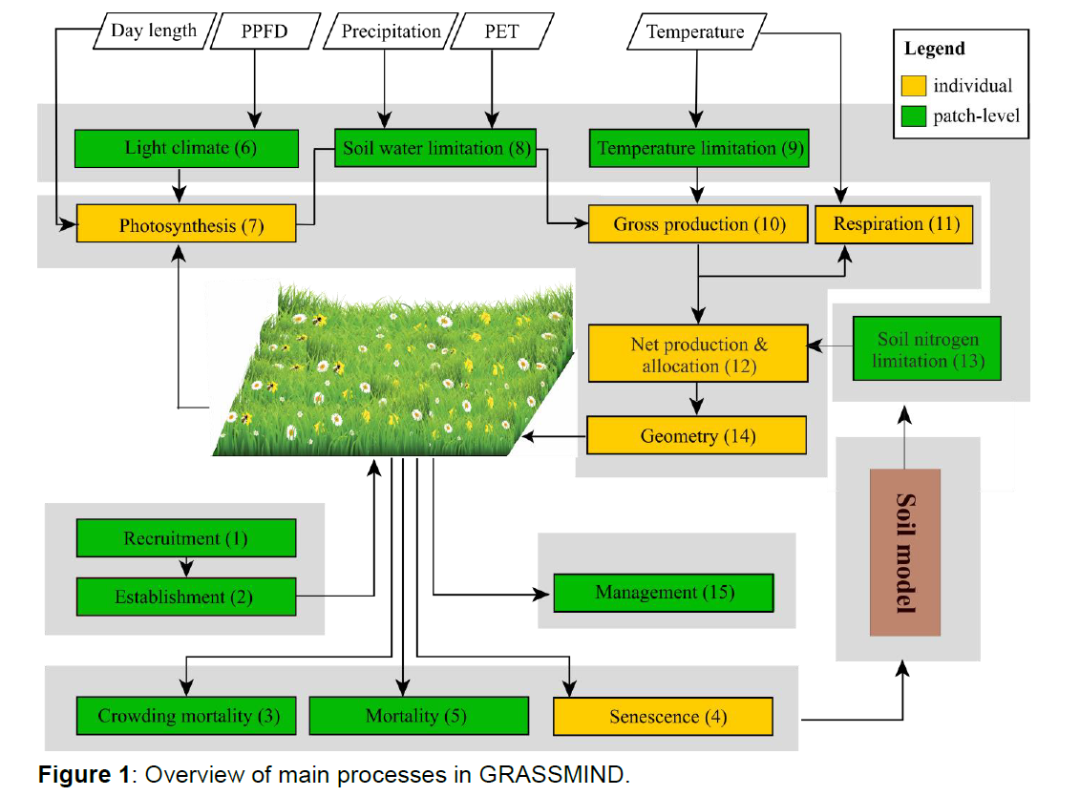
Dataset:
Agent-based model for simulating collective dynamics of plant growth
Variables like:
plant geometry
surrounding plant density
nutrient distribution
sunlight
etc…..

Slide 20
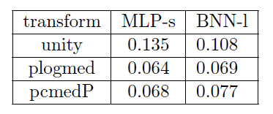
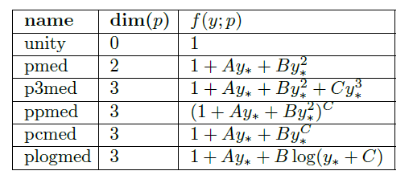
Different transformations
As mentioned, optimising RMSCM for conformalised BNN does not lead to lower RMSCM than for conformalised MLP
(transform “unity” means “before any optimisation”)
Here, the parameter vector notation is $p=\left(A, B, C…\right)$
Transformation used in slides is “pcmed”
Notes:
The one we used was pcmed.
Interesting to note: all (3-dim) transf. produced quite comparable RMSCM when optimised, the pattern is quite easy to learn (after all, it is one-dim., and quite well behaved/monotonous function: “more errors near to median and vice versa”)

Slide 21
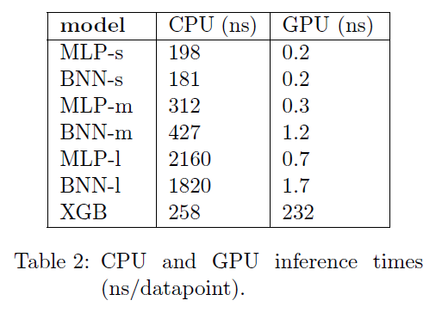
Computational cost: BNN vs MLP
One single run of BNN with same number of neurons as an MLP has roughly the same computational cost.
But BNN is stochastic, and to get good mean prediction (and ANY UQ), multiple runs are needed. A PI constructed from sampling such BNN 100x is roughly 100x more computationally expensive than a run of MLP with our UQ.
NB: BNN used in the presentation is called BNN-l (large) in the paper, and it has more neurons than MLP-s (small)

Slide 22
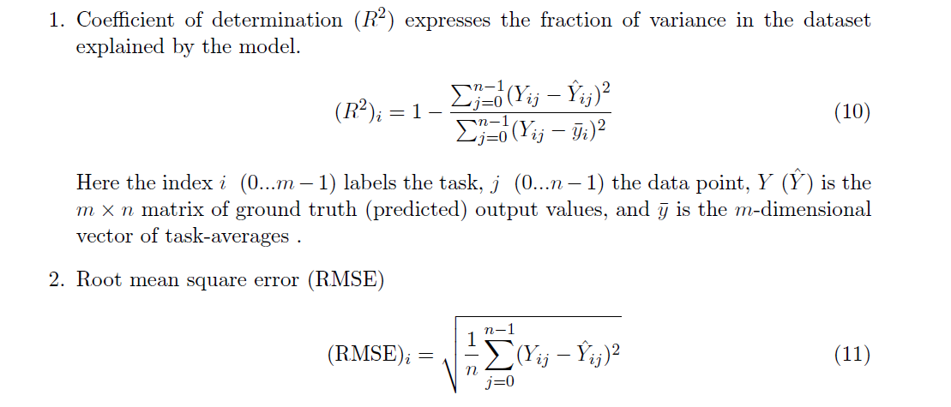
Performance metrics used in presentation

Slide 23
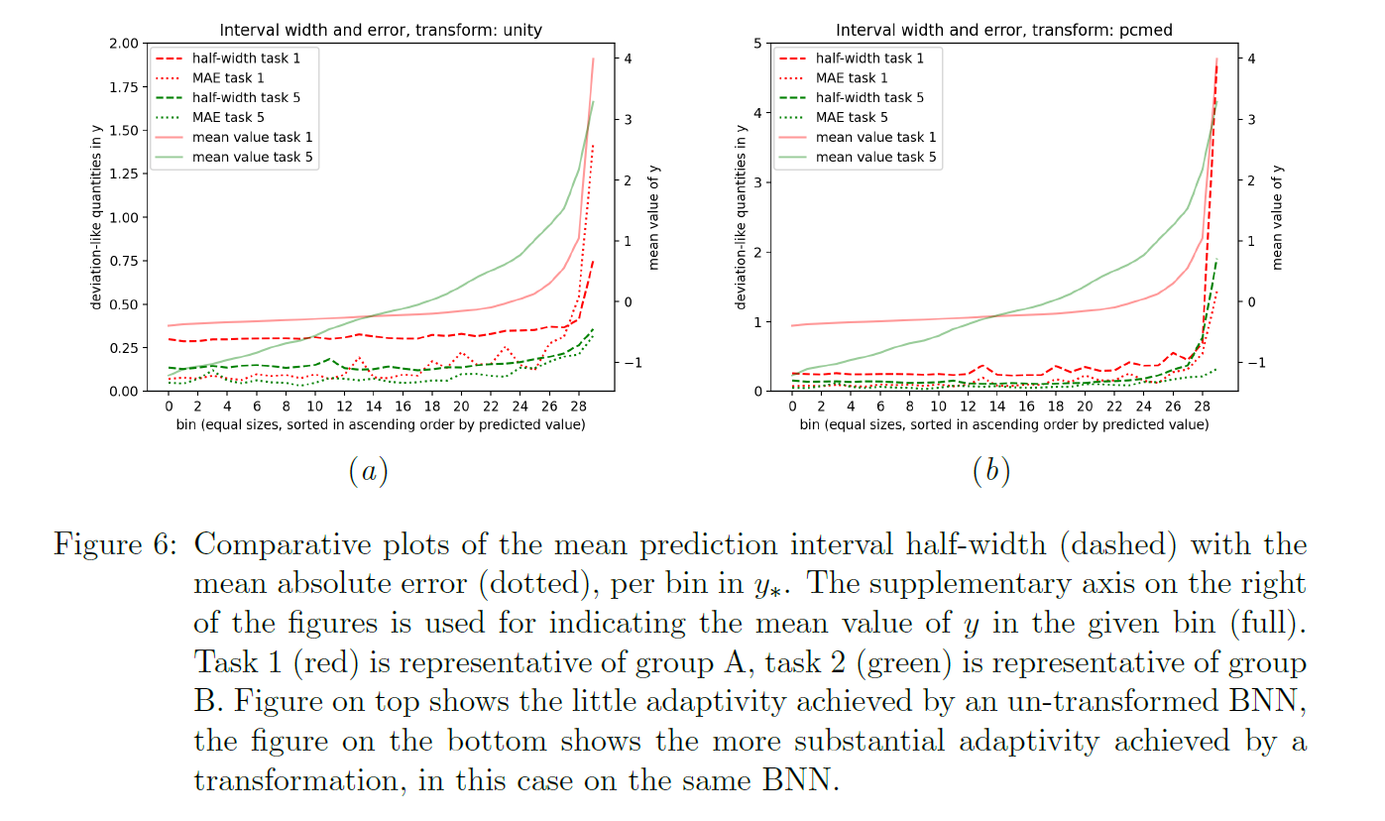
Errors and PI widths
Notes:
Probably too difficult slight to actually use, but it shows how PI width and mean commited error vary across bins (representing y-hat), instead of the more abstract coverage. Simply said, if errors grow faster with y-hat than PI, algorithm undercovers the peaks and vice versa.

Slide 24
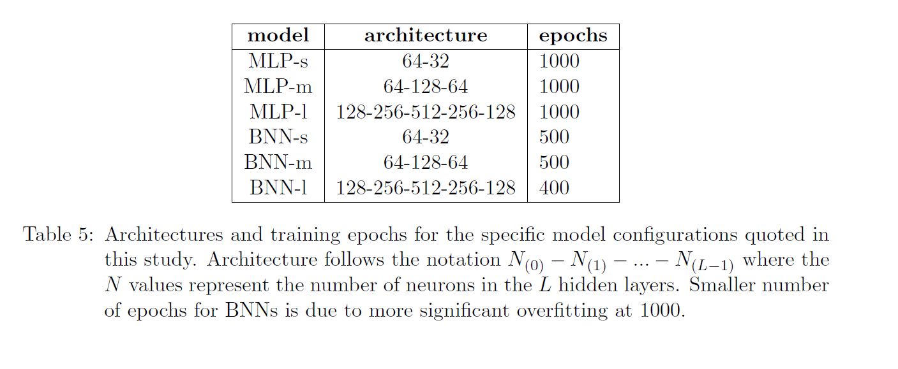
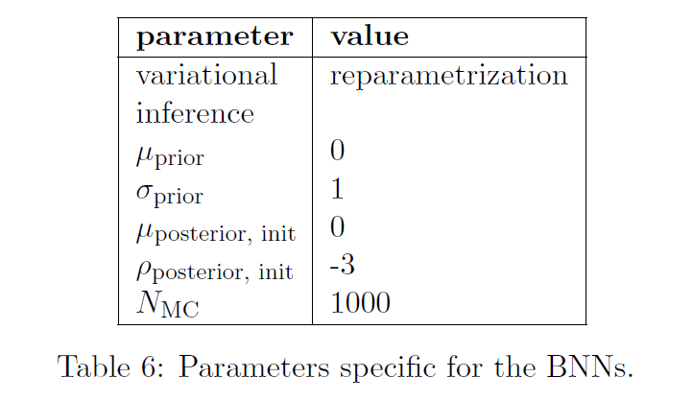
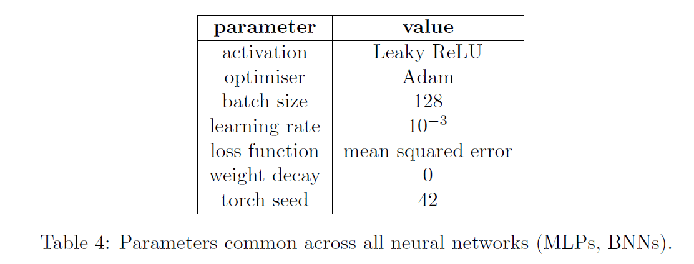
Implementation details
Notes:
Does anyone even care?

Slide 25
(SLIDE WITH THE ORIGINAL COMPOSITE GRAPHIC – IF IT NEEDS MODIFICATION)
sometimes a full physical simulation is impractical (computational cost too high)
data-driven metamodels can achieve most of the precision at much smaller cost
can train deep learning models on
(i) directly the real-world data common ML
(ii) physical model output that we want to emulate metamodelling
domain knowledge
train dataset
meta-model
metamodel predictions
physical model
real world data???
validation dataset
new real world data

