Slide 1
Evidential Uncertainty Sets in Deep Classifiers Using Conformal Prediction
The 13th Symposium on Conformal and Probabilistic Prediction with Applications
Hamed Karimi and Reza Samavi
Department of Electrical, Computer, and Biomedical Engineering Toronto Metropolitan University Toronto, ON, Canada
September 9th, 2024

Slide 2
Conformal Prediction
[Vovk et al., 2005]
For a given
Classification model $ℳ$ estimating $ℳ_{y}\left(x\right)=ℙ[𝒴=y|𝒳=x]$ (black box model)
Split CP: An i.i.d. unseen hold-out set ${\{\left(x_{i},y_{i}\right)\}}_{i=1}^{n}\sim ℙ$
A new image $x_{new}$
Predict a set $𝒞(x_{new})⊆Y=\{1,2,…,K\},$which contains the true class with high probability (error rate $δ$):
Using non-conformity score function: A measure of difference (discrepancy) between labeled examples to compare a new (unseen) data point with those in a hold-out set
Coverage Theorem: $1−δ≤ℙ[y_{n+1}∈∁_{n+1}]$ $≤1−δ+\frac{1}{n+1}$
Notes:
For any given classification model

Slide 3
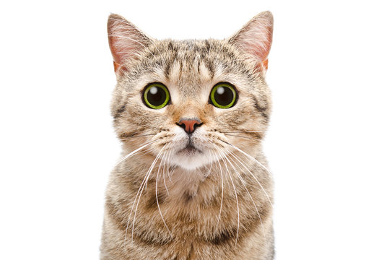
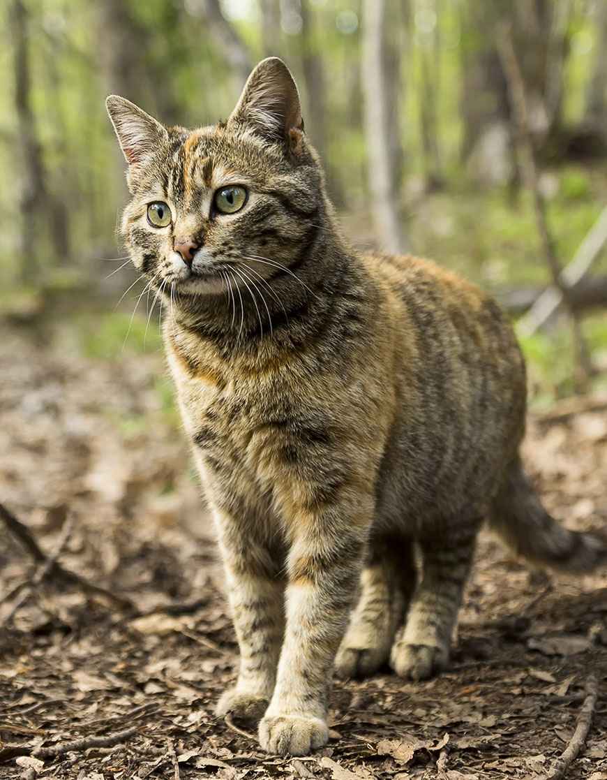
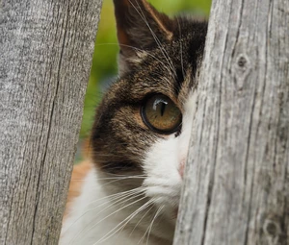
Prediction Set Properties
Marginal coverage of the true label
To guarantee that the prediction set includes the true label with the probability of at least $1−δ$
Set size
To represent instance-wise model uncertainty: a prediction set with a smaller size represent more certain prediction.
Adaptivity
To produce larger prediction sets for more difficult data points
Difficulty of a test data point is the rank of its true label in the sorted set of outcome probabilities
$$\left\{{domestic cat \atop 0.98}\right\}$$
$$\left\{{domestic cat \atop 0.67},{lynx \atop 0.22},{caracal \atop 0.06},{serval \atop 0.03}\right\}$$
$$\left\{{lynx \atop 0.42},{domestic cat \atop 0.27},{caracal \atop 0.18},{serval \atop 0.08},{cougar \atop 0.02},{ocelot \atop 0.01} \right\}$$
Notes:
the set size is smaller when the model encounters easier test data rather than the inherently harder ones.
for example, the set size property tries to make the sets smaller, while the adaptivity property tries to make the sets larger for harder data points when the model is uncertain, or choosing the fixed-size sets may satisfy the coverage property, but without adaptivity.
These properties affect each other

Slide 4
Related Work
Adaptive Prediction Set (APS): To produce adaptive sets using a novel conformity score [Romano et al. 2020]
Large prediction sets because of less confident classes (tail probabilities) that cannot precisely represent the model uncertainty
Regularized Adaptive Prediction Sets (RAPS): To relax the impact of the noisy probability estimates [Angelopoulos et al. 2020]
Produces smaller prediction sets
Penalizing each class beyond the most $k_{reg}$ likely classes with a constant $λ$ to discourage its inclusion in the prediction set
- Romano, Y., Sesia, M., & Candes, E. (2020). Classification with valid and adaptive coverage. Advances in Neurips, 33, 3581-3591.
- Angelopoulos, A.; Bates, S.; Malik, J.; and Jordan, M. I. 2020. Uncertainty sets for image classifiers using conformal prediction. arXiv preprint arXiv:2009.14193.

Slide 5
Research Contributions
Proposing the new concept of Evidential Conformal Prediction (ECP) to represent model uncertainty
By generating small and adaptive prediction sets
Devising a novel evidential non-conformity score using evidential properties
Uncertainty surprisal
Expected utility
Notes:
- To enhance the accuracy and reliability of uncertainty estimation in real-world applications
- To equip medical professionals with a more reliable and guaranteed uncertainty quantification and support their decision-making process

Slide 6
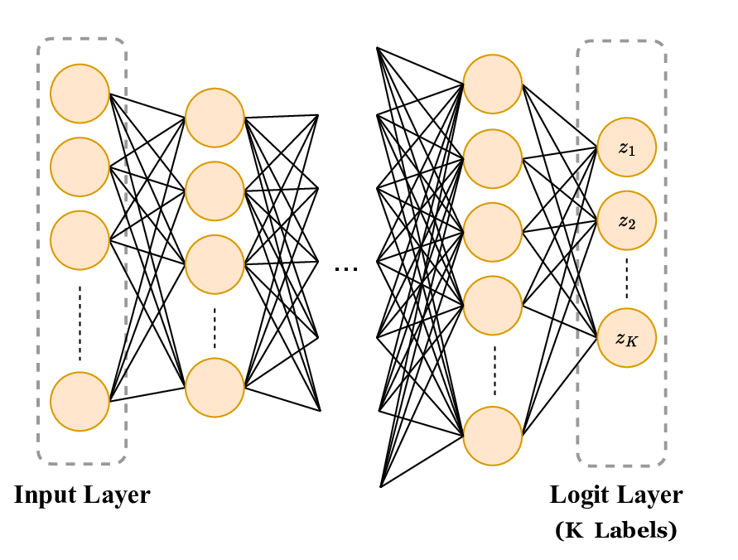
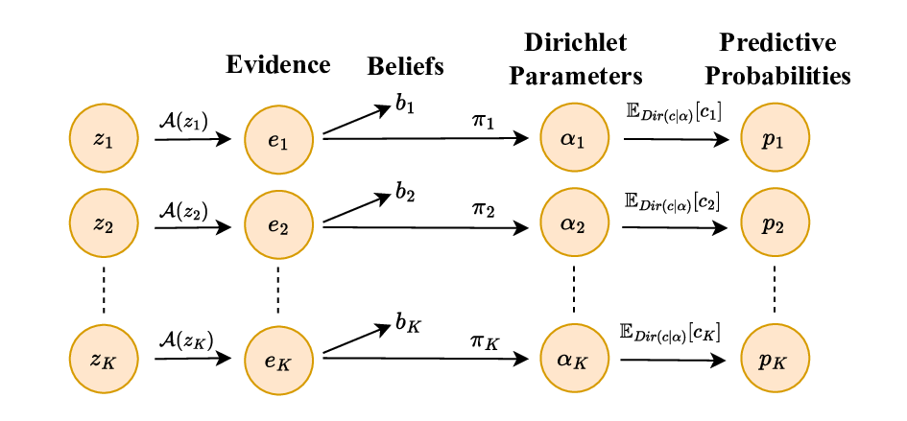
Evidential Conformal Prediction (ECP)
Goal: Use evidence from all classes to define the heuristic notion of uncertainty
Generate evidence from logit values
Form a Dirichlet Distribution with parameters $α_{1},…,α_{K}∈α$
Generate predictive probability $p_{k}∈ℙ$associated with the label 𝑘
Assign Belief masses $b_{1},…,b_{K}$to all labels
Focal uncertainty of each label 𝑘: a heuristic notion of uncertainty
$$e_{k}=𝒜(z_{k})$$
$$α_{k}=e_{k}+Kπ_{k} s.t. π_{k}=\frac{1}{K} ⟹ α_{k}=e_{k}+1$$
$$α_{0}=\sum_{k=1}^{K}{α_{k}}=K+\sum_{k=1}^{K}{e_{k}}$$
$${𝔼_{Dir(c|α)}\left[c_{k}\right]=p}_{k}=\frac{α_{k}}{α_{0}}$$
$$b_{k}=\frac{e_{k}}{α_{0}} and u=\frac{K}{α_{0}} ⟹ u+\sum_{k=1}^{K}{b_{k}=1}$$
$$U_{k}=uπ_{k}$$

Slide 7
Score Function Based on Evidential Classification Cost (ECC)
ECC estimates how much each target label $k∈Y$is not a correct choice to classify a particular data point
Compute Focal Uncertainty Surprisal $I_{U}(k)$
Compute Expected Utility $Φ(k)$
Incorporate Example Difficulty $ρ(k)$ based on label rank $r_{k}$
Compute the cost (ECC) $C_{k}$associated with label $k$
Compute non-conformity score function $S_{ECC}(k)$ of label $k$
Compute $\hat{q}$ as $\left(1−δ\right)$-quantile of $S_{ECC}(k=y_{true})$
Form the uncertainty set $𝒞$
$$I_{U}(k)=\frac{U_{k}I(k)}{p_{k}}$$
$$U_{k}=uπ_{k} and I\left(k\right)=−\log{p_{k} } ⟹$$
$$Φ(k)=φ_{k}p_{k}$$
$$ρ(k)=\frac{K}{K−r_{k}}$$
$$C_{k}=\frac{ρ\left(k\right)I_{U}(k)}{Φ(k)}=−Ku\frac{π_{k}.\log{p_{k}}}{φ_{k}p_{k}^{2}(K−r_{k})}$$
$$∀k∈Y:{ S}_{ECC}(k)=\frac{C_{k}}{\max_{ν∈Y}{C_{ν}}}$$
$$𝒞\left(x_{val},\hat{q}\right)=\left\{k∈Y|S_{ECC}\left(k\right)≤\hat{q}\right\}$$
Notes:
Goal: form the score function for higher adaptivity and smaller set size
Design Decision:
when the rank of label k denoted by rk ∈ {0, 1, ..., K − 1} in a descending-sorted set of predictive probabilities ⟨P ⟩ is higher, the ECC associated with the label k is also increased
C^hat: label evidential cost
Sort them (descending) based on softmax to find out the difficulty leve (r_y)l

Slide 8
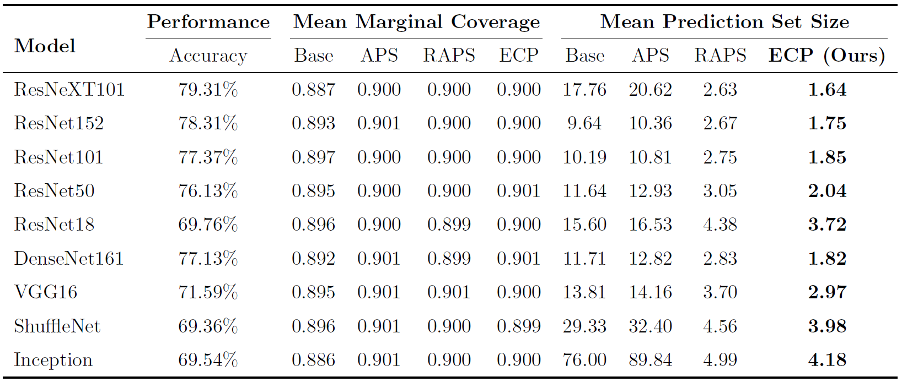
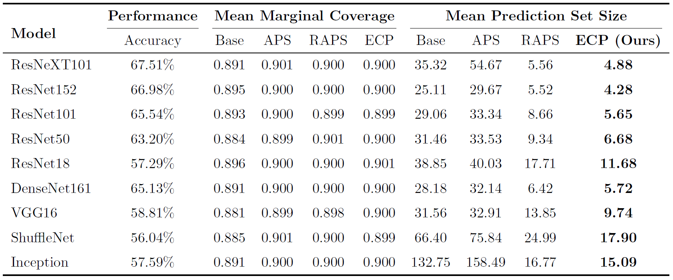
Experimental Evaluation: Prediction Set Size
Goal: Producing efficient (small size) prediction sets while maintaining coverage guarantee and adaptivity
Using ImageNet-Val and ImageNet-V2 as testing datasets
Base method generates prediction sets by including labels from the most likely to the least likely probabilities until their cumulative summation exceeds the threshold $1−δ$
Testing on ImageNet-Val with $δ=0.1$
Testing on ImageNet-V2 with $δ=0.1$

Slide 9
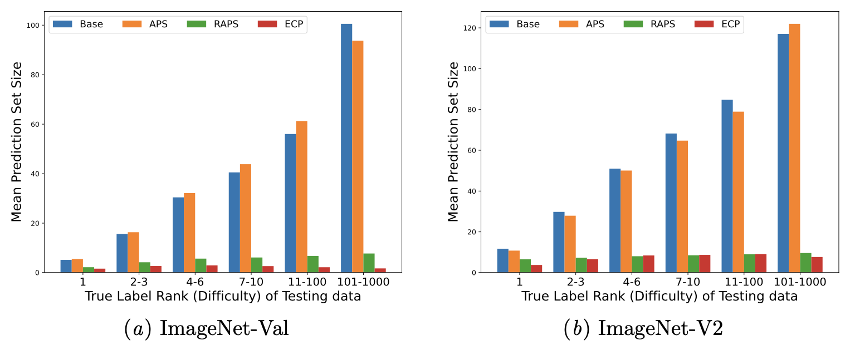
Experimental Evaluation: Prediction Set Adaptivity
Adaptivity in prediction sets using ResNet152

Slide 10
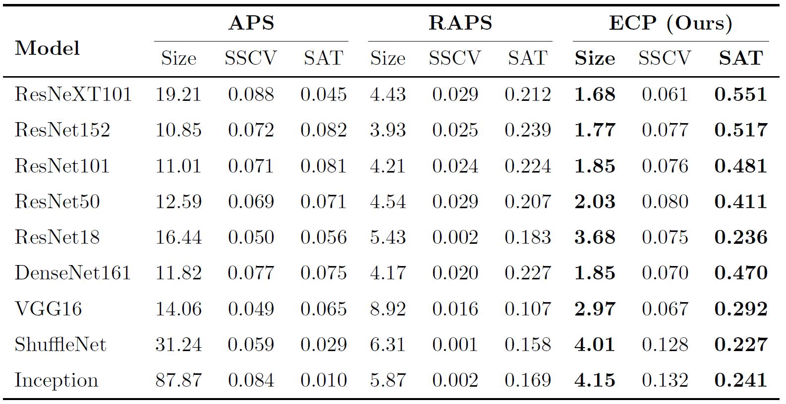
Experimental Evaluation: Size-adaptivity Trade-off (SAT)
SAT represents the quality of prediction sets (ImageNet-Val with $δ=0.1$)
Size-stratified Coverage Violence (SSCV) [Angelopoulos et al. 2020]
Coverage guarantee in size-stratified prediction sets (conditional coverage)
Size-adaptivity Trade-off (SAT score):
$$SAT\left(𝒞\right)=\frac{1−SSCV(𝒞)}{μ(𝒞)}$$
where $μ\left(𝒞\right)$ is the average set size
Angelopoulos, A.; Bates, S.; Malik, J.; and Jordan, M. I. 2020. Uncertainty sets for image classifiers using conformal prediction. arXiv preprint arXiv:2009.14193.

Slide 11
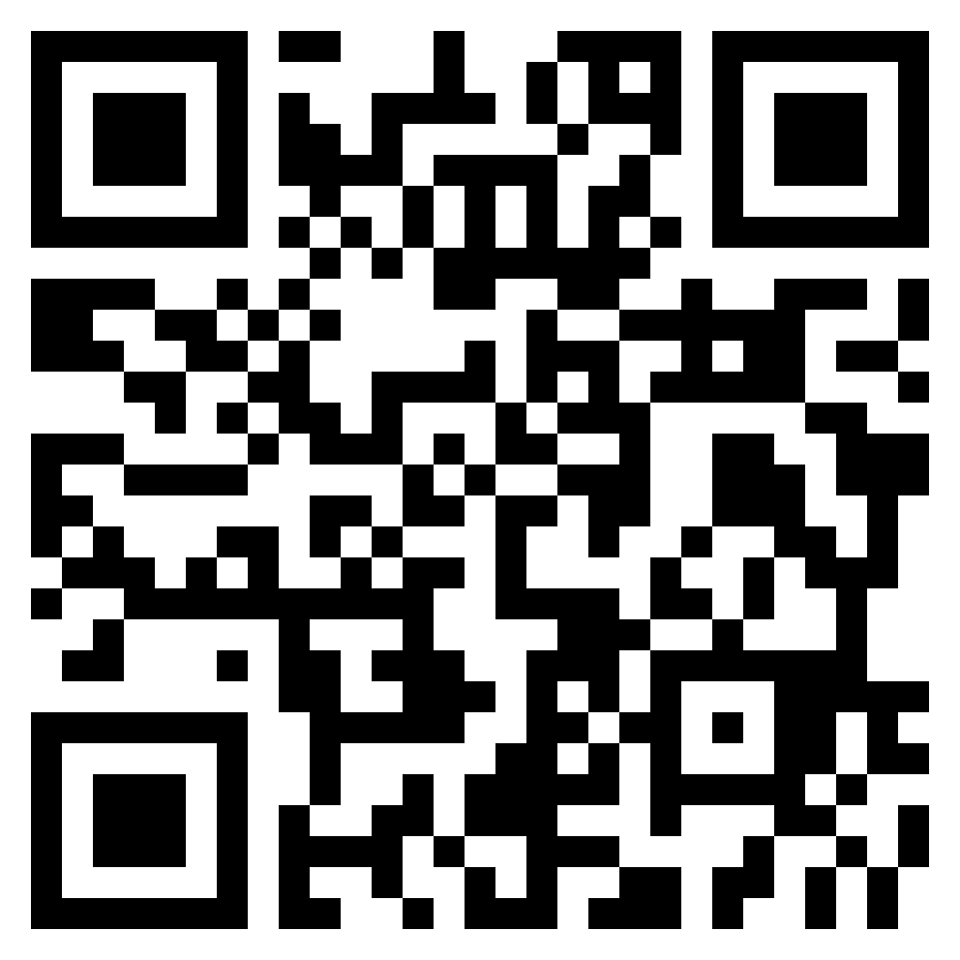
Conclusion and Future Work
We proposed a novel non-conformity score function and introduce evidential CP (ECP)
Using evidential properties
ECP produced efficient and adaptive prediction sets while maintaining the coverage of true labels
With no additional optimization process or computational burden
Our extensive experimental evaluations showed that ECP could outperform the state-of-the-art CP methods in terms of set size and adaptivity
As our future work, we will investigate applying ECP on multi-label classification tasks or when encountering distribution shift
Thank You
For Your Attention
Please feel free to contact me at:
hamed.karimi@torontomu.ca
Website: https://www.ecb.torontomu.ca/~samavi/

Slide 12
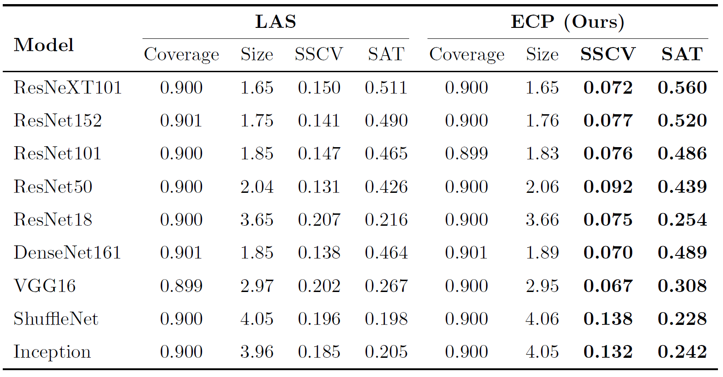
Experimental Evaluation: ECP vs. LAS
SAT represents the quality of prediction sets (ImageNet-Val with $δ=0.1$)
Comparing ECP with Least Ambiguous Set-valued (LAS) method [Sadinle et al. 2019]
Uses one minus the temperature-scaled softmax scores as its non-conformity function
Produces small prediction sets
Size-stratified Coverage Violence (SSCV) [Angelopoulos et al. 2020]
Coverage guarantee in size-stratified prediction sets (conditional coverage)
Size-adaptivity Trade-off (SAT score):
$$SAT\left(𝒞\right)=\frac{1−SSCV(𝒞)}{μ(𝒞)}$$
where $μ\left(𝒞\right)$ is the average set size
- Sadinle, M., Lei, J., & Wasserman, L. (2019). Least ambiguous set-valued classifiers with bounded error levels. Journal of the American Statistical Association, 114(525), 223-234.
- Angelopoulos, A.; Bates, S.; Malik, J.; and Jordan, M. I. 2020. Uncertainty sets for image classifiers using conformal prediction. arXiv preprint arXiv:2009.14193.

Slide 13
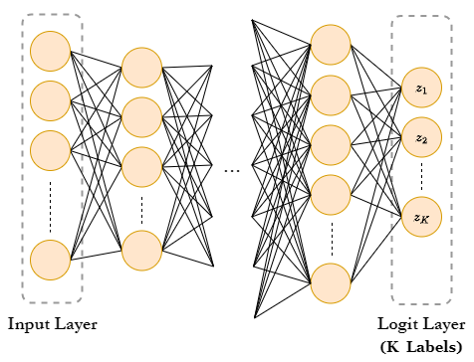
Uncertainty Quantification
Popular approaches, e.g., Bayesian methods such as MC-Dropout [Gal and Ghahramani 2016] and Deep-Ensemble [Lakshminarayanan et al. 2016], and Evidential approaches [Sensoy et al. 2018; Yuan et al. 2020]
Only point-estimation of uncertainty
Dependent on data and/or model parameters distributions
Lack of validity guarantees
To address this challenge, Conformal Prediction (CP) method is considered [Vovk et al. 2005; Papadopoulos et al. 2002]:
Set-estimation of uncertainty
As a post-processing technique
Distribution free
By offering a statistically reliable indicator of uncertainty
CP turns a heuristic notion of uncertainty into a rigorous one
$$p_{1}=0.10$$
$$p_{2}=0.40$$
$$p_{K}=0.15$$
Vladimir Vovk, Alexander Gammerman, and Glenn Shafer. Algorithmic learning in a random world, 2005.
Notes:
Or Conformal Inference

Slide 14
How to Achieve the Prediction Set
Consider an unseen data point $x∈X_{cal}$, and the corresponding model output $y∈Y=\{1, 2, …,K\}$.
To construct the prediction set as a rigorous uncertainty estimation, we require to:
Identify a heuristic notion of uncertainty using the pretrained model.
Devise a non-conformity score function $s(x, y)∈ℝ$. Larger value of the score function indicates higher model uncertainty.
Compute $\hat{q}$ as the $\frac{⌈(n+1)(1−δ)⌉}{n}$ quantile of the calibration scores ${\left\{s_{i}=s\left(x_{i}, y_{i}\right)\right\}}_{i=1}^{n}$ using the coverage error level $δ$ and for $n$ unseen calibration data points.
Use this quantile $\hat{q}$ to form the prediction sets for testing data $x_{val}∈X_{val}$ as,
$$C(x_{val},\hat{q})=\{y: s(x_{val}, y)≤\hat{q}\}$$
Heuristic Uncertainty
Conformal Prediction
Rigorous Uncertainty
Notes:
In conformal prediction, we generally take any heuristic notion of model uncertainty associated with the input data point in any data distribution and any model, and transform this uncertainty to a rigorous form.

Slide 15
Non-conformity Score Function
A measure of similarity between labeled examples which is used to compare a new data point to among those in a hold-out set
$$E.g. S(x,y)=1−p(x,y)$$
How can we construct a statistically valid prediction set even if the heuristic notion of uncertainty of the underlying model is arbitrarily bad?
If the scores correctly rank the inputs from lowest to highest magnitude of model error, then the resulting sets will be smaller for easy inputs and bigger for hard ones $⟹$ Adaptivity
If the scores are bad, in the sense that they do not approximate this ranking, then the sets will be useless.
Although the guarantee holds, the usefulness of the prediction sets is primarily determined by the non-conformity score function
Notes:
- For example, if the scores are random noise, then the sets will contain a random sample of the label space, where that random sample is large enough to provide valid marginal coverage.
- The score function incorporates almost all the information we know about our problem and data, including the underlying model itself.

Slide 16
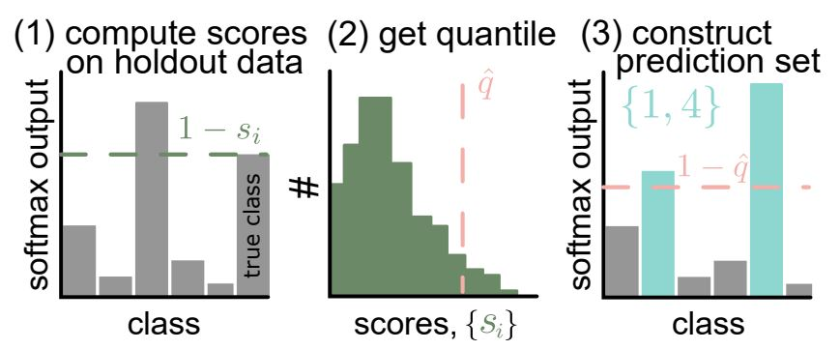
Related Work
Naive Approach generates prediction sets for test data using a score function and include labels from the most likely to the least likely probabilities until their cumulative summation exceeds the threshold $1−δ$
Using softmax probabilities is error-prone, particularly in tail probabilities leading to large sets
This method does not have finite marginal coverage guarantee
Temperature scaling cannot solve this problem
$$At least 90\% of S\left(x,y=l\right) is less than \hat{q}$$
$$S(x,y)=1−σ_{xy}≤\hat{q} ⟹ σ_{xy}≥1−\hat{q}$$
$$C\left(X_{new}\right)=\left\{y∈Y | S(X_{new},y)≤\hat{q}\right\}$$
Angelopoulos, Anastasios N., and Stephen Bates. "Conformal prediction: A gentle introduction." Foundations and Trends® in Machine Learning 16.4 (2023): 494-591.
Notes:
There are two problems with the naive method: first, the probabilities output by deep classifiers are known to be incorrect and miscalibrated (Nixon et al., 2019), specifically, tail probabilities, leading to large sets that do not correctly represent the model uncertainty and do not achieve coverage. Second, for examples where the model is not confident, the naive strategy must select many classes before it reaches the desired confidence level, leading to a large set size.
- Temperature scaling cannot solve this problem, since it only calibrates the score of the top classes, and it is intractable to calibrate the rest. Perhaps surprisingly, even if all scores were perfectly calibrated, naive still would not achieve coverage.
The coverage problem can be solved by picking a new threshold using holdout samples.
- For example, with α =10%, if choosing sets that contain 93% estimated probability achieves 90% coverage on the holdout set, we use the 93% cutoff instead.
- RAPS is a modification of the conformal score from APS [Romano et al. (2020)] to have smaller, more stable sets.

Slide 17
Related Work (Cont.)
Adaptive Prediction Set (APS) provides marginal coverage of true label in the prediction set which was also fully adaptive to complex data distributions using a novel conformity score [Romano et al. 2020]
However, APS still produces large prediction sets because of less confident classes (tail probabilities) which cannot precisely represent the model uncertainty

Slide 18
Related Work (Cont.)
Regularized Adaptive Prediction Sets (RAPS) was introduced to relax the impact of the noisy probability estimates which yield to smaller and more stable prediction sets [Angelopoulos et al. 2020]
Every class beyond the most $k_{reg}$ likely classes is subject to a constant regularization penalty $λ$ which discourages its inclusion in the predictive set
However, there is lack of interpretability in this approach
Maybe more adaptivity in the new approach, we will investigate further

Slide 19
The first CP algorithm
[Vovk et al., 2005]
Learn a rule to predict the set with the coverage guarantee in mind.
1. Get the score of the correct class, for each of $\left(x_{i},y_{i}\right)$
2. Take the $≈α\%$ (e.g., 10%)
quantile of all scores
3. Construct prediction set for $x_{n+1}$
$$E_{i}$$
$∁_{n+1}=${All classes whose score exceeds $\hat{q}$ when $x_{n+1}$ is the input}
$$\hat{q}=quantile(\left[E_{1},…, E_{n}\right], α)$$
Score: $p(x_{i})$
At least $\left(1−α\right)\%$ of examples have their true scores above $\hat{q}$.
Score: $p(x_{n+1})$
$$\hat{q}$$
$$y_{i}$$
$$∁_{n+1}=\{2, 4, 7\}$$
Slide credit: Anastasios Nikolas Angelopoulos
Notes:
At least 90% of our examples from the calibration dataset have their true scores above this number (q^).
10% of the mass (true scores) falls below q^ and 90% of the mass falls above it.

Slide 20
The second CP algorithm: Adaptive Prediction Set
[Romano et al., 2020]
1. Get the score of the correct class, for each of $\left(x_{i},y_{i}\right)$ and sort all scores
2. Take the $≈(1−α)\%$ (e.g., 90%)
quantile of all scores
3. Construct prediction set for $x_{n+1}$
$∁_{n+1}=${The $r$ most likely classes, where $\sum_{i=1}^{r}{ℳ(x_{n+1})≥}\hat{q}$All classes whose score exceeds $\hat{q}$}
$E_{i}=\sum_{i=1}^{r}{ℳ(x_{i})}$,
where r is the rank of the correct class
$$\hat{q}=quantile(\left[E_{1},…, E_{n}\right], α)$$
Score: $p(x_{i})$
At least $\left(1−α\right)\%$ of examples have their true scores above $\hat{q}$.
Score: $p(x_{n+1})$
$$y_{i}$$
$$∁_{n+1}=\{2, 4, 7, 0\}$$
First CP Algo | Second CP Algo
Only uses the output of true class Not very adaptive Smallest average size | Uses outputs of all classes Designed to be more adaptive Usually larger size
Yaniv Romano, Matteo Sesia, and Emmanuel Candes. Classification with valid and adaptive coverage. Neurips’2020
Notes:
The first method I showed you has the first property and in fact provides the smallest average set size but not good with adaptivity, large set for hard problem and small for easy

Slide 21
The second CP algorithm: Adaptive Prediction Set
[Romano et al., 2020]
First CP Algo | Second CP Algo
Only uses the output of true class Not very adaptive Smallest average size | Uses outputs of all classes Designed to be more adaptive Usually larger size
1. Get the score of the correct class, for each of $\left(x_{i},y_{i}\right)$ and sort all scores
2. Take the $≈(1−α)\%$ (e.g., 90%)
quantile of all scores
3. Construct prediction set for $x_{n+1}$
$E_{i}=\sum_{i=1}^{r}{ℳ(x_{i})}$,
where r is the rank of the correct class
$∁_{n+1}=${The $r$ most likely classes, where $\sum_{i=1}^{r}{ℳ(x_{n+1})≥}\hat{q}$All classes whose score exceeds $\hat{q}$}
$$\hat{q}=quantile(\left[E_{1},…, E_{n}\right], α)$$
Score: $p(x_{i})$
At least $\left(1−α\right)\%$ of examples have their true scores above $\hat{q}$.
Score: $p(x_{n+1})$
$$y_{i}$$
$$∁_{n+1}=\{2, 4, 7, 0\}$$
Yaniv Romano, Matteo Sesia, and Emmanuel Candes. Classification with valid and adaptive coverage. Neurips’2020
Notes:
The first method I showed you has the first property and in fact provides the smallest average set size but not good with adaptivity, large set for hard problem and small for easy

Slide 22
The second CP algorithm: Adaptive Prediction Set
[Romano et al., 2020]
First CP Algo | Second CP Algo
Only uses output of true class Not very adaptive Smallest average size | Uses outputs of all classes Designed to be more adaptive Usually larger size
1. Get the score of the correct class, for each of $\left(x_{i},y_{i}\right)$ and sort all scores
2. Take the $≈(1−α)\%$ (e.g., 90%)
quantile of all scores
3. Construct prediction set for $x_{n+1}$
$E_{i}=\sum_{i=1}^{r}{ℳ(x_{i})}$,
where r is the rank of the correct class
$∁_{n+1}=${The $r$ most likely classes, where $\sum_{i=1}^{r}{ℳ(x_{n+1})≥}\hat{q}$All classes whose score exceeds $\hat{q}$}
$$\hat{q}=quantile(\left[E_{1},…, E_{n}\right], α)$$
Score: $p(x_{i})$
At least $\left(1−α\right)\%$ of examples have their true scores above $\hat{q}$.
Score: $p(x_{n+1})$
$$y_{i}$$
$$∁_{n+1}=\{2, 4, 7, 0\}$$
Slide credit: Anastasios Nikolas Angelopoulos
Yaniv Romano, Matteo Sesia, and Emmanuel Candes. Classification with valid and adaptive coverage. Advances in Neural Information Processing Systems, 33:3581–3591, 2020.
Notes:
The first method I showed you has the first property and in fact provides the smallest average set size but not good with adaptivity, large set for hard problem and small for easy

Slide 23
Interpretability of ECP
Interpretability is about the extent to which a cause and effect can be observed within a system
The extent to which we can predict what is going to happen, given a change in algorithmic parameters
The degree to which a human can understand the cause of a decision (Causality)
When an algorithm/model explains its decisions, it is easier and more acceptable to be applied to real-world tasks (Trust)
Informativeness:
Incorporates uncertainty mass associated with the outcomes
Incorporates base rates (prior probabilities) associated with the target labels
Incorporates rank of true label in the sorted set of predictive probabilities to ensure adaptiveness
$$S_{k}∝\frac{ρ.I_{U} \left(k\right)}{Λ\left(k\right)}$$
Molnar, Christoph. Interpretable machine learning. Lulu. com, 2020.
Kim, Been, Rajiv Khanna, and Oluwasanmi O. Koyejo. “Examples are not enough, learn to criticize! Criticism for interpretability.” NurIPS (2016).
Notes:
In interpretability is not about what is your results; it is about why you achieved this result.

Slide 24
Outline
Research Motivation
Research Background
Research Methodology
Evaluations

