Slide 1



The 13th Symposium on Conformal and
Probabilistic Prediction with Applications (COPA2024)
Milano, 09-11/09/2024
“A probabilistic scaling approach to conformal prediction in binary image classification”
Alberto Carlevaro, Sara Narteni, Fabrizio Dabbene, Teodoro Alamo*, Maurizio Mongelli
Cnr-Istituto di Elettronica e di Ingegneria dell’Informazione e delle Telecomunicazioni
*University of Seville

Slide 2

AGENDA
Introduction
  Safety in binary classification
  Problem formulation
Theory
  Probabilistic Safety Regions
  Scalable Classifiers
  How to build a Safe Set
Deep Probabilistic Scaling
Link with Conformal Prediction
  Score function for scalable deep neural networks
Experiments and Results
Conclusions
A probabilistic scaling approach to conformal prediction in binary image classification, 09/09/2024
Notes:
2

Slide 3


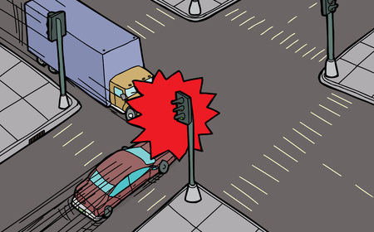


Safety in binary classification
Classify symptoms/medical data
+1 safe: healthy
-1 unsafe: not healthy
Classify safe/unsafe driving conditions
+1 safe: clear crossing
-1 unsafe: risk of accident
A probabilistic scaling approach to conformal prediction in binary image classification, 09/09/2024
Notes:
3

Slide 4
How to design a "safe" classifier
We would like a ML classifier whose safety we can trust.
In other words, when the ML says that the current value x is safe, this should come with some probabilistic confidence.
In general, classifiers designed through classical methods (e.g. SVM, kNN, LR, NN) do not come with these guarantees.
Assume we have already designed a classifier using some labelled data.
Can we change/modify it so that it provides safety guarantees?
YES, through proper calibration.
A probabilistic scaling approach to conformal prediction in binary image classification, 09/09/2024
Notes:
4

Slide 5

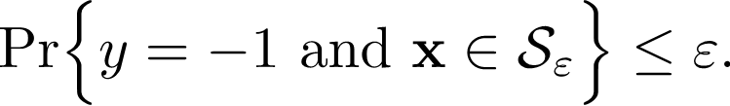

Probabilistic Safety Region
We define a Probabilistic Safety Region (PSR)
To design such region, we use an additional set of labelled data, the so-called calibration set
TOOL: We define a (very general) class of classifiers named scalable classifiers.
A probabilistic scaling approach to conformal prediction in binary image classification, 09/09/2024
Notes:
5

Slide 6
Scalable Classifiers
A probabilistic scaling approach to conformal prediction in binary image classification, 09/09/2024
Notes:
6

Slide 7
Scalable Classifiers
A probabilistic scaling approach to conformal prediction in binary image classification, 09/09/2024
Notes:
7

Slide 8
Safe set
We define the - safe set
A probabilistic scaling approach to conformal prediction in binary image classification, 09/09/2024
Notes:
8

Slide 9
Construction of safe set
We are given a calibration set of size
We consider the unsafe points in
For each point compute
Take the r-th maximum
Consider probabilistic parameters
If and
then
is a PSR
A probabilistic scaling approach to conformal prediction in binary image classification, 09/09/2024
Notes:
9

Slide 10
Deep Probabilistic Scaling
True label is 7
Original classification is 7
Scaled classification is 7
True label is 7
Original classification is 7
Scaled classification is not 7
True label is 1
Original classification is 1
Scaled classification is 1
A probabilistic scaling approach to conformal prediction in binary image classification, 09/09/2024
Notes:
10

Slide 11
Link with conformal prediction
Given a scalable classifier
Recall that
Then, for a scalable classifier, a score function is immediately obtained as
A probabilistic scaling approach to conformal prediction in binary image classification, 09/09/2024
Notes:
11

Slide 12

Score function for scalable deep neural networks
Standard score function
Probabilisitic Scaling score function
They act the same because they differ for a constant !
A probabilistic scaling approach to conformal prediction in binary image classification, 09/09/2024
Notes:
12

Slide 13
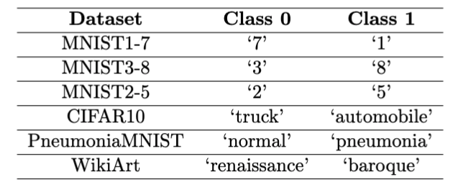
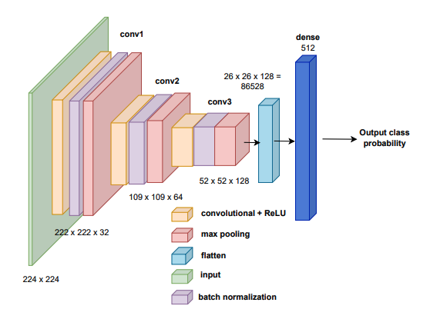
Experiments settings
Binary classification scenarios from open-source datasets
Pretrained convolutional NN
  3 conv layers + 1 FC layer + output
  Adam optimizer with learning rate 0.001
Error level: = 0.01
A probabilistic scaling approach to conformal prediction in binary image classification, 09/09/2024
Notes:
13

Slide 14
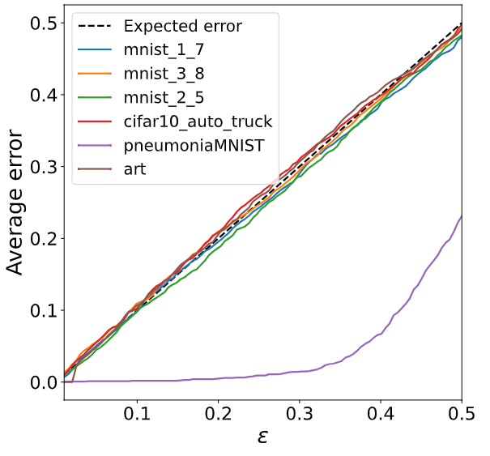
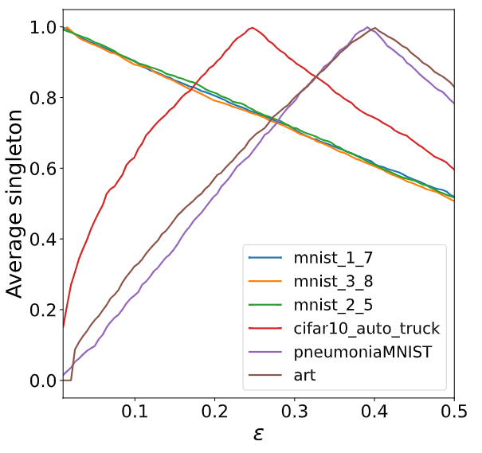
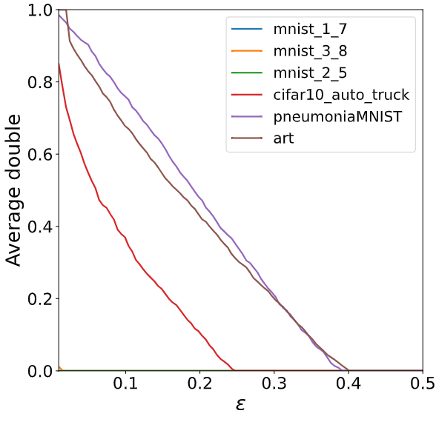
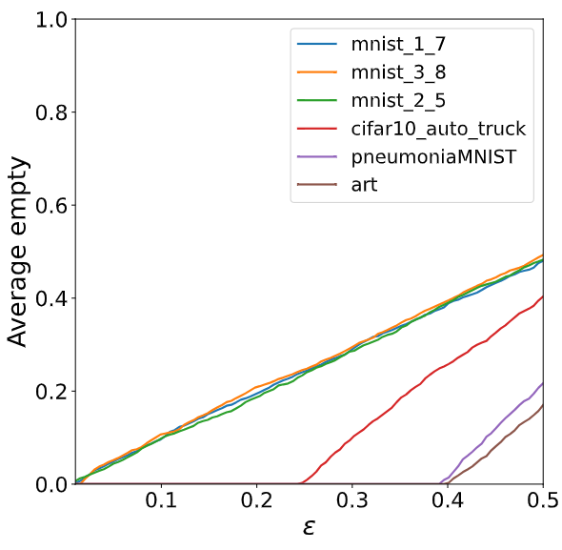
Results – score function for scalable cnn
The introduced score generated a coherent behavior with respect to accuracy and efficiency
  MNIST (simplest cases) : no double sets
  Other datasets: more double sets for lower
A probabilistic scaling approach to conformal prediction in binary image classification, 09/09/2024
Notes:
14

Slide 15
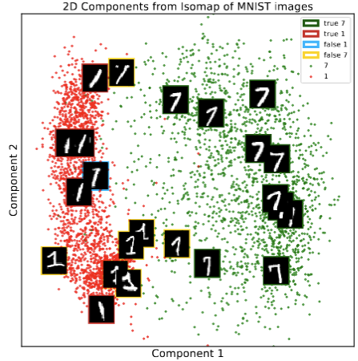
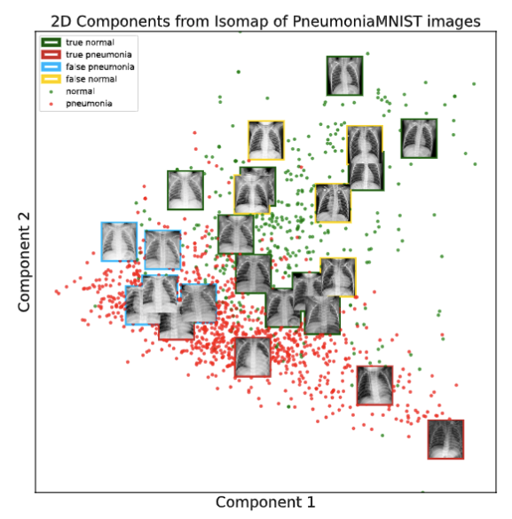
Results – probabilistic safety regions
Labelling based on DPS
Probabilistic guarantees on the error, while providing explainability
Regions of safe predictions → images that most conform to the target class
A probabilistic scaling approach to conformal prediction in binary image classification, 09/09/2024
Notes:
15

Slide 16
conclusions
Deep Probabilistic Scaling (DPS) as a way to provide error control to binary image classification
It draws a bridge between probabilistic scaling and conformal prediction theories
  Designed a score function from DPS, proved to be equivalent to canonical sigmoid-based CP score function
It allows to define new connections between CP and order statistics
A probabilistic scaling approach to conformal prediction in binary image classification, 09/09/2024
Notes:
16

Slide 17
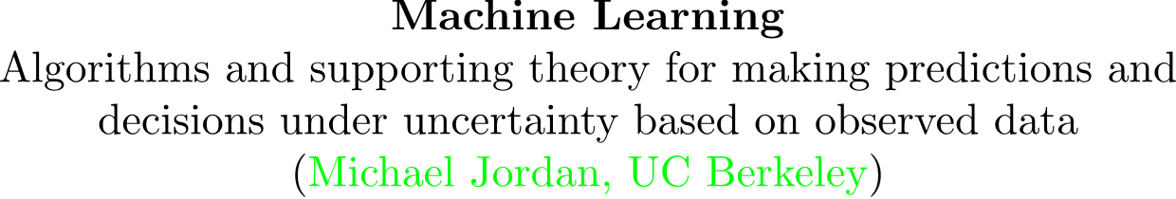
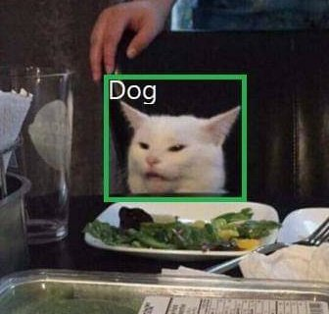



The 13th Symposium on Conformal and
Probabilistic Prediction with Applications (COPA2024)
Milano, 09-11/09/2024
Thank you for
your attention!
albertocarlevaro@cnr.it, saranarteni@cnr.it, fabrizio.dabbene@cnr.it, talamo@us.es, maurizio.mongelli@cnr.it
Paper code and data:
https://github.com/AlbiCarle/Deep-Probabilistic-Scaling

