Slide 1
Distribution-free risk assessment of regression-based machine learning algorithms
Sukrita Singh (University of Oxford/ Munich Re), Neeraj Sarna (Munich Re)
Joint work with:
Yuanyuan Li, Yang Lin , Michael Berger (Munich Re),
Agni Orfanoudaki (University of Oxford)
September 2024
Notes:
Thank you for a great conference – I have been learning a lot about new work in this space. Thank you for giving us the opportunity to share our work on risk assessment of regression based machine learning algorithms. I am Sukrita Singh and I am presenting together with Neeraj Sarna and one of our collaborators Michael Berger, is supporting us from the audience. This is joint work between University of Oxford and Munich Re, a reinsurance company.

Slide 2
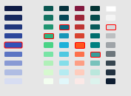
Agenda
01
02
03
04
Motivation
Methodology
Results
Next Steps

Slide 3
Motivation

Slide 4
AI Risks Performance guarantees can be backed by insurance
Performance Risk
Model
AI Vendor
End User
IP Infringement Risk
Performance
guarantees
Insurance Policy
Discrimination Risk
Munich Re
Notes:
When we look at the setting where AI models are used for practical applications, there are risks associated such as performance, IP infringement, fairness. All these risks can incur financial costs for the end user and depending upon the application area this can be severe. And as an insurer, what you would like to do is enable an AI vendor to extend a performance guarantee to the end user. Give example of drug dosage.

Slide 5
Regression case: Defining under-performance
Defining risk by critical safety threshold
$\hat{µ}$(x) + ε
$\hat{µ}$(x)
$\hat{µ}$(x)
$\hat{µ}$(x) - ε
y
y
x
x
Under-performance = $Y_{test}$ is outside $\left[μ\left(X_{test}\right)−\text{ε},μ\left(X_{test}\right)\text{+ }\text{ε}\right]$
Failure Probability =$P(Y_{test}$ is outside $\left[\hat{µ}\left(X_{test}\right)−\text{ε},\hat{µ}\left(X_{test}\right)\text{+ }\text{ε}\right])$
Notes:
The problem is that under performance is defined on an error threshold which is fixed and maybe set by regulatory, government or legal standards. Something that may be outside the control of the AI vendor and the end user both so it is important to estimate coverage in respect of this defined interval instead of obtaining conformal prediction intervals for a predefined coverage level. So basically our problem is the inverse of standard conformal prediction.

Slide 6
Pricing performance risk Defining model under-performance
$$\text{Expected} \text{C}\text{laims} \text{C}\text{ost} \text{=} \text{Claim} \text{Frequency} \text{X} \text{Claim} \text{Severity}$$
Independent of the extent of underperformance
Claim Frequency = Number of instances of model under-performance
= Number of times model is used X Probability of under-performance
Function of model performance to be estimated
Will not depend on model’s performance
Failure Probability =$P(Y_{test}$ is outside $\left[\hat{µ}\left(X_{test}\right)−\text{ε},\hat{µ}\left(X_{test}\right)\text{+ }\text{ε}\right])$

Slide 7
Risk Assessment: Methodology

Slide 8
Risk Assessment Defining constraints and desired properties
Problem Constraints
Desirable Properties
Label collection infrequent
Access to a (relatively) small hold out set$\left\{\left(X_{i},Y_{i}\right)\right\}i$
Access to a large test set (no labels) $\left\{Xi\right\}i$
No control over model architecture and error
Error tolerance pre-defined
δ = Estimated – True Failure Probability
Conservativeness:
Don’t under-estimate the failure probability
(δ > 0)
Accuracy:
Estimate the failure probability as accurately as possible (Small |δ|)
Notes:
First of all, we translate the business scenario so far in terms of what it means for the theoretical constraints of the solution we wish to obtain. To summarize, the main constraints are epsilon is fixed so there is no control over error threshold. Next, the model comes from a third party – all you’re doing is evaluate it so there is no control over model architecture itself (and in some cases also limited access to it). We have to estimate the failure probability adhering to 2 principles; it should be conservative and it should be as accurate as possible.

Slide 9
Computation of Failure Probability : Notation Mathematical formulation
Given data point, $\left\{\left(X_{i},Y_{i}\right)\right\}$
Model prediction of target: $μ(X_{i})$
Risk tolerance: $τ\left(X_{i}\right)$(because tolerance can be absolute or relative)
Run a CP algorithm on the calibration set to obtain scores: $e\left(X_{i},Y_{i}\right)=| Y_{i} − μ\left(X_{i}\right)|$
Upper and lower bound on prediction: ${V_{i}}^{±}(X)$ = $μ\left(X_{i}\right)±e\left(X_{i},Y_{i}\right)$

Slide 10
Computation of Failure Probability : Proposed methodology Under exchangeability
$$V_{i}^{−} (X)$$
$$μ(x)$$
$$μ\left(x\right)−τ(x)$$
$$μ\left(x\right)+τ(x)$$
$$V_{i}^{+} (X)$$
$$α^{−}\left(X\right)= \frac{2}{5}$$
$$α^{+}\left(X\right)= \frac{3}{5}$$
$$α\left(X\right)=max⁡(α^{−}\left(X\right),α^{+}\left(X\right))= \frac{3}{5}$$
Average $α\left(X\right)$ over points in the hold out set to give $\hat{α}$

Slide 11
Computation of Failure Probability : Proposed methodology Under covariate shift
$$V_{i}^{−} (X)$$
$$μ(x)$$
$$μ\left(x\right)−τ(x)$$
$$μ\left(x\right)+τ(x)$$
$$V_{i}^{+} (X)$$
Under covariate shift where weights are known for e,g assume
$$=2∗$$
$$α^{−}\left(X\right)= p_{1}+p_{2}= \frac{3}{8}$$
$$α^{+}\left(X\right)= p_{3}+p_{4}+p_{5}= \frac{5}{8}$$
$$α\left(X\right)=max⁡(α^{−}\left(X\right),α^{+}\left(X\right))= \frac{5}{8}$$
Average $α\left(X\right)$ over points in the hold out set to give $\hat{α}$

Slide 12
Results

Slide 13
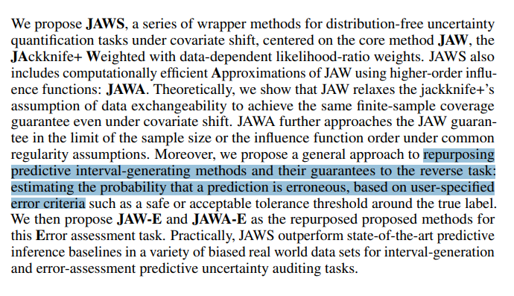
Theoretical Results Proving desired properties
Previous Work
Extension
Introduce a hold-out test to capture randomness and propose a lower variance solution
Theoretically prove that the risk assessment method provides a conservative and accurate solution
Application of the methodology to real-life datasets
*

Slide 14
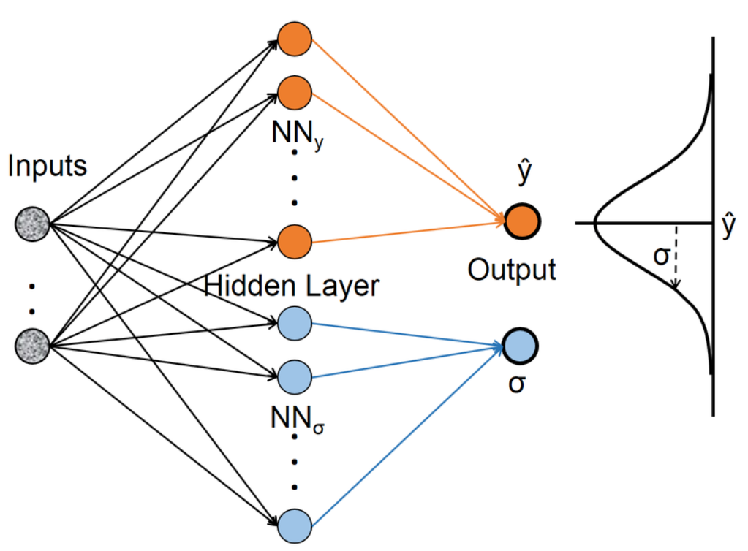
Experimental Results Methodology
Public dataset with neural network models
Method-1 Mean-variance estimation
Method-2 normal distribution over residuals
Exponential tilting for distribution shift [Tibshirani et.al. 2019]
Counting based estimate empirical estimate of the true failure probability

Slide 15
Experimental Results Predictive maintenance: Gas turbines (1/2)
Risk underestimation

Slide 16
Experimental Results Predictive maintenance: Gas turbines (2/2)

Slide 17
Experimental Results Energy Output: Power plant

Slide 18
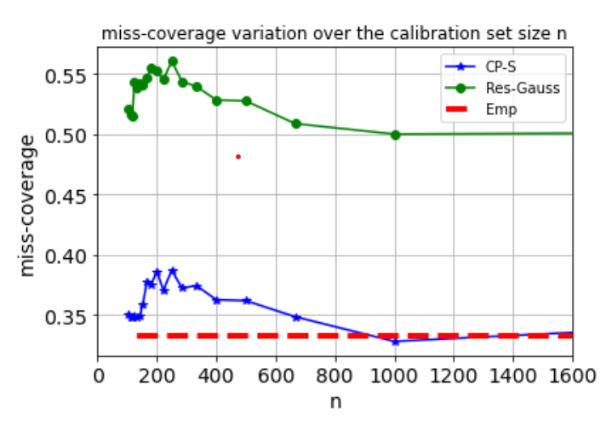
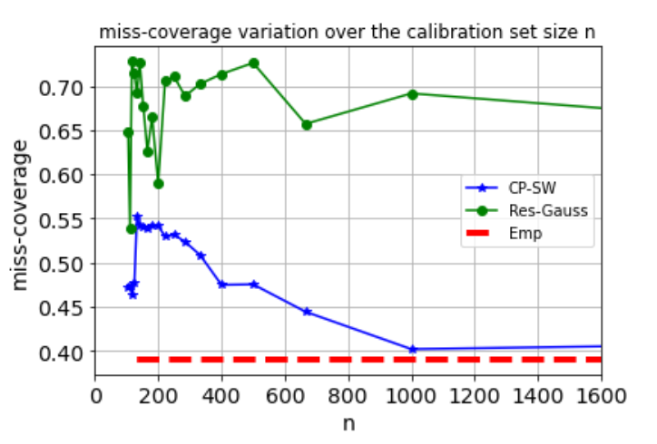
Experimental Results Convergence with number of calibration points
Without distribution shift
With distribution shift

Slide 19
Next steps Future direction to explore
Theoretical:
Handling other types of data drifts
Performance evaluation when weights are numerically approximated
Extension to classification problems
Application:
Evaluation of discrimination risks
Thank You! Questions?

